Slide 1

Real Estate and Economic Outlook

Slide 2
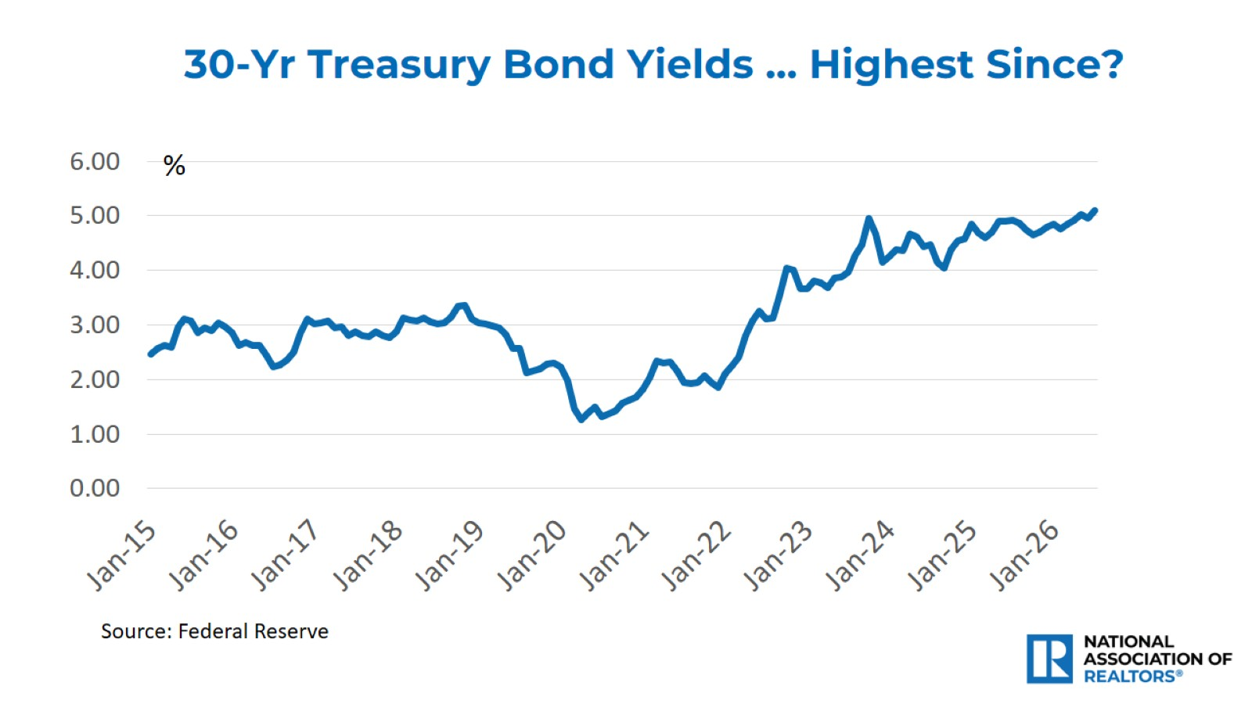

Slide 3
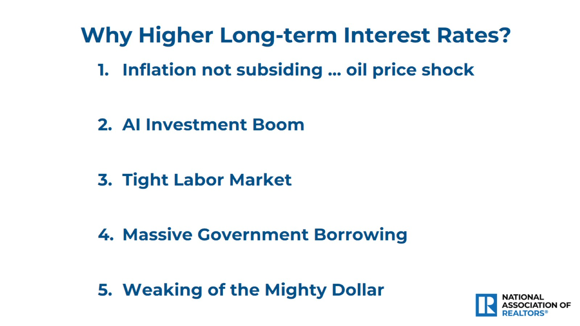

Slide 4
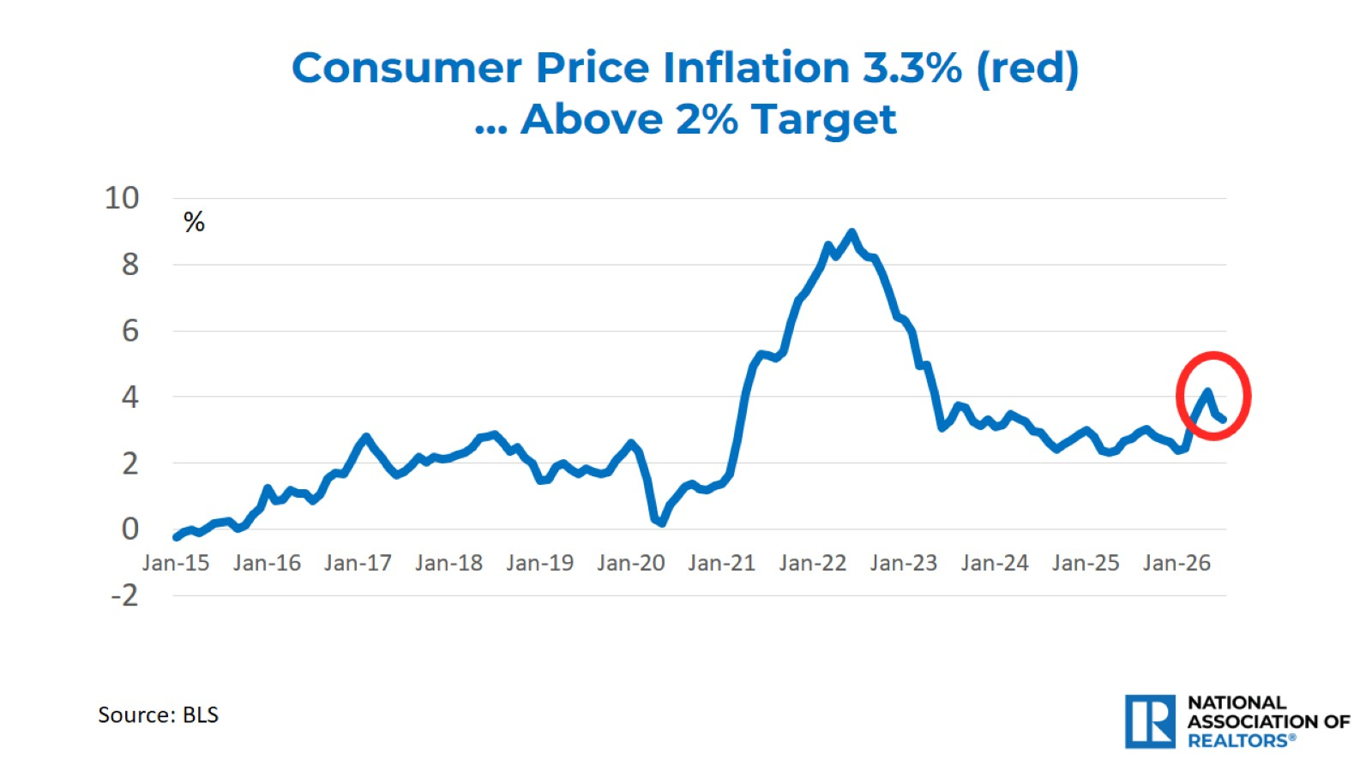

Slide 5
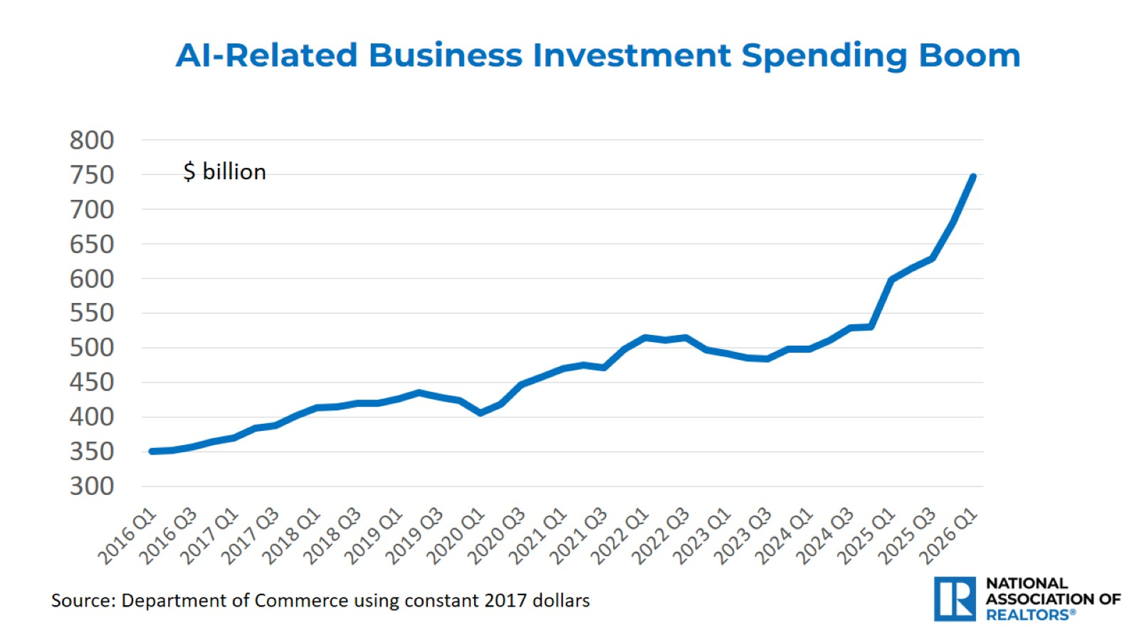

Slide 6
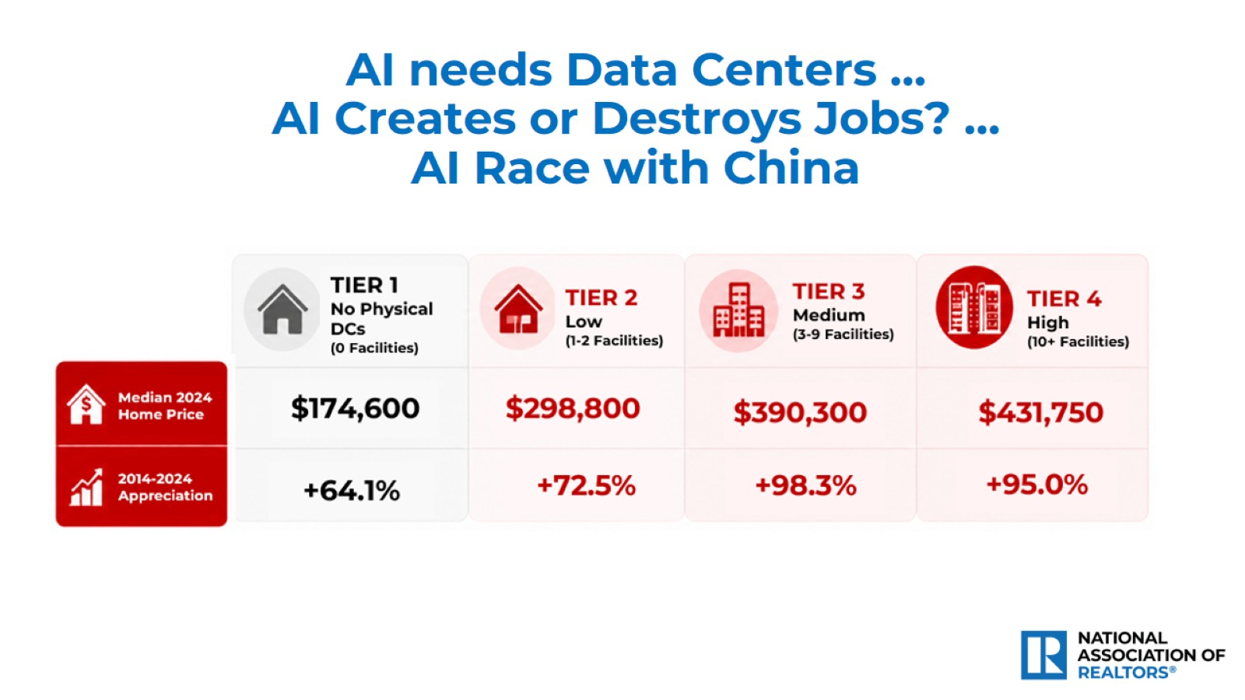
AI needs Data Centers …
AI Creates or Destroys Jobs? …
AI Race with China

Slide 7
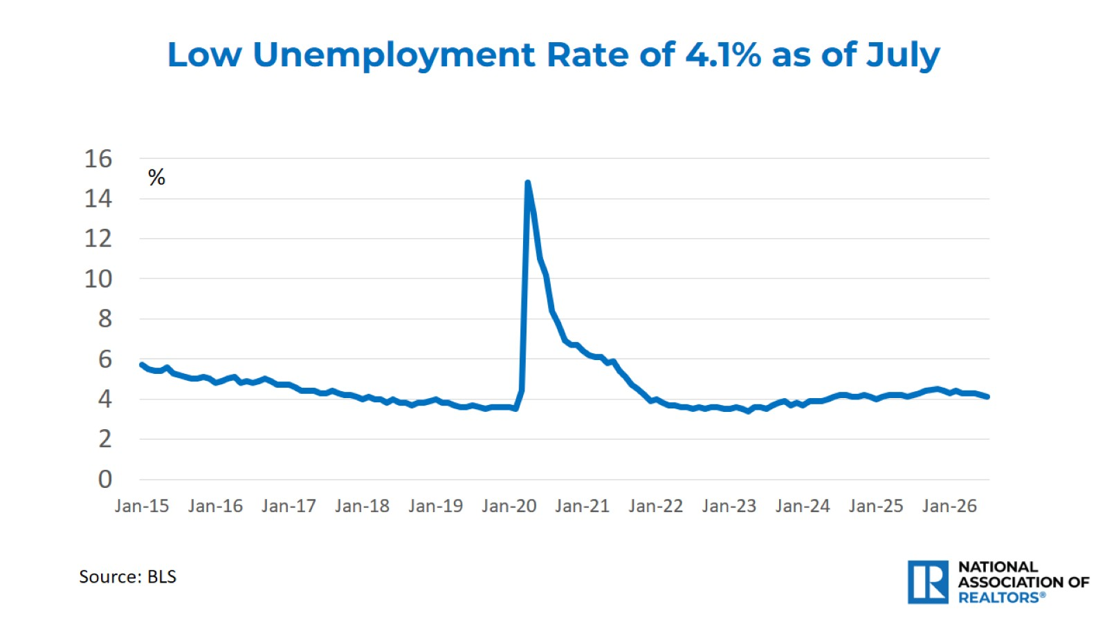

Slide 8
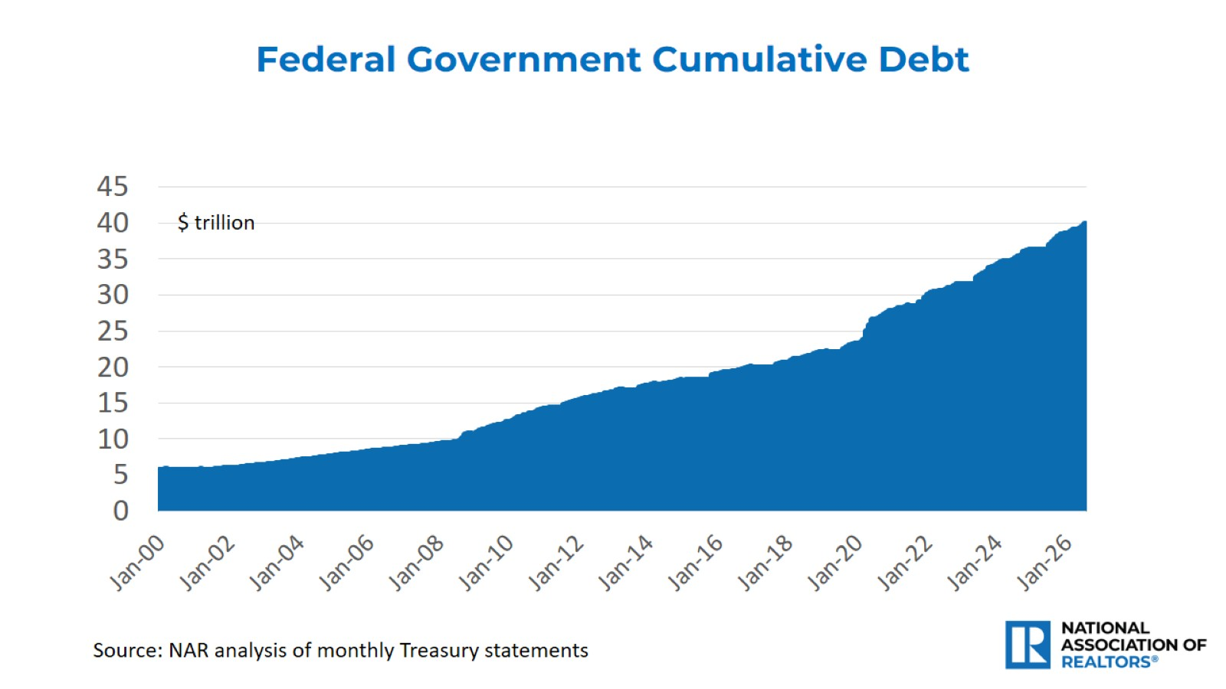

Slide 9
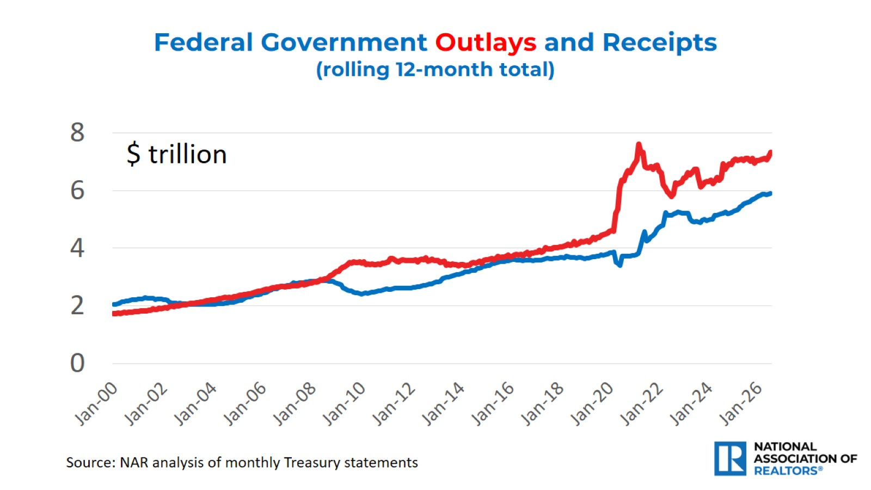

Slide 10
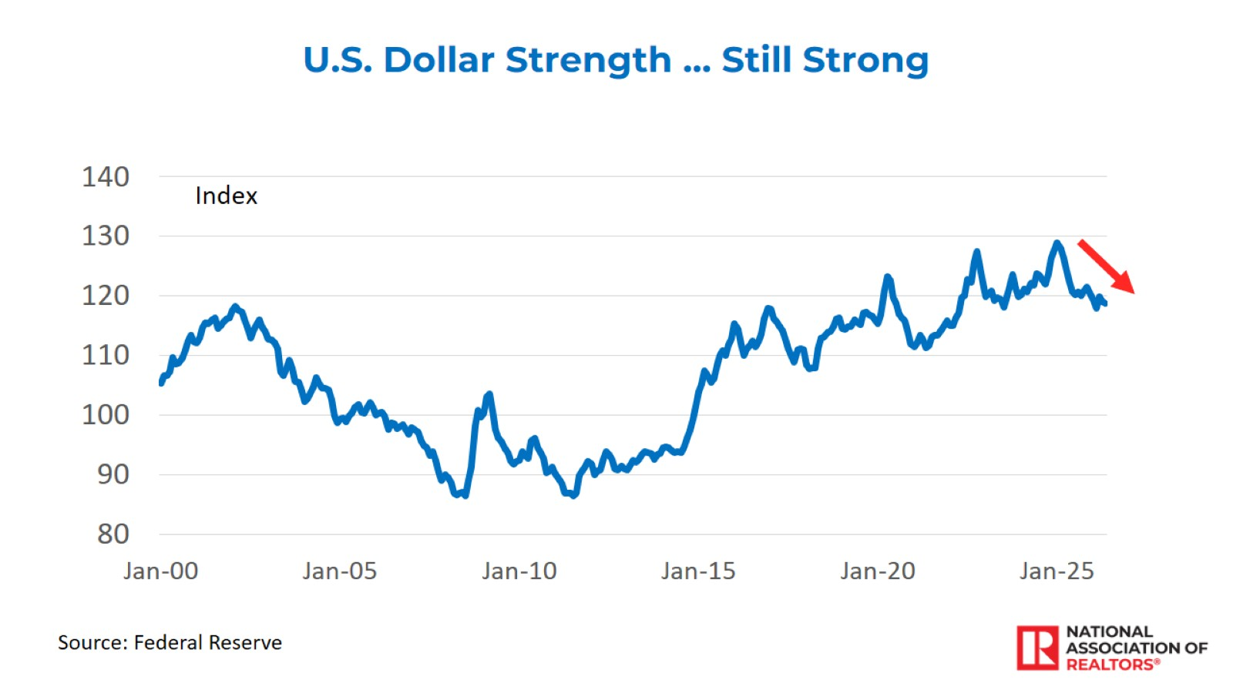

Slide 11
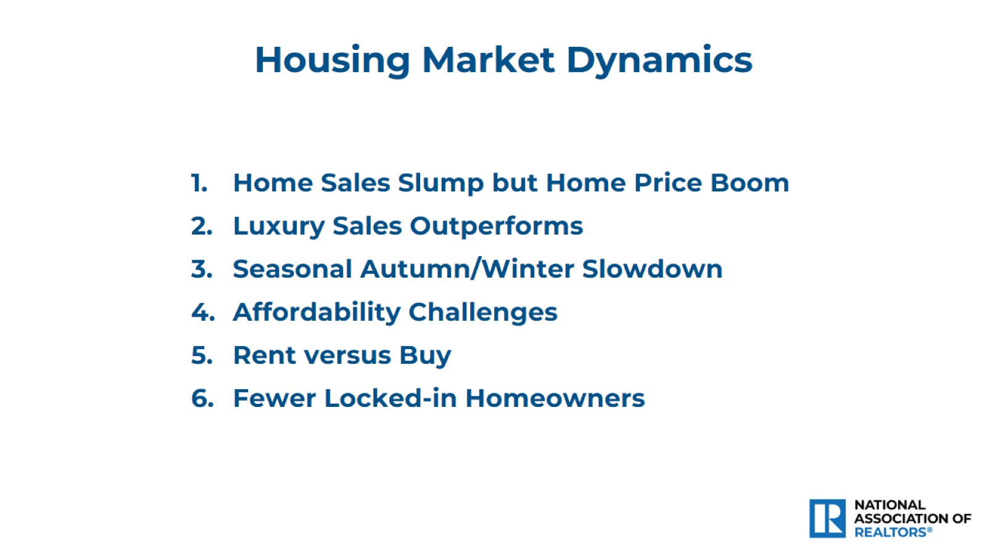

Slide 12
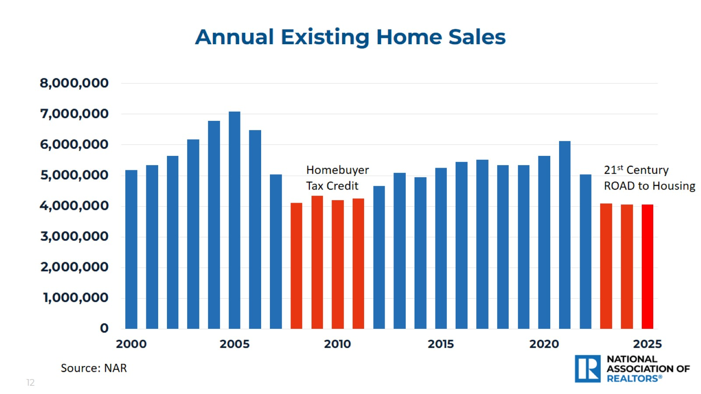
Annual Existing Home Sales

Slide 13
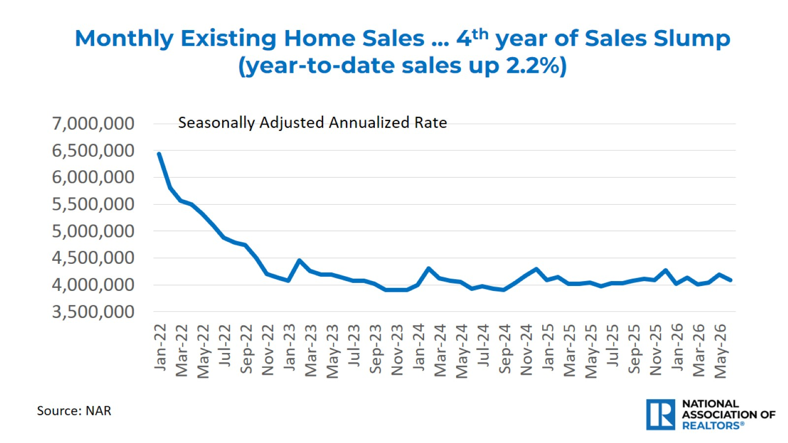

Slide 14
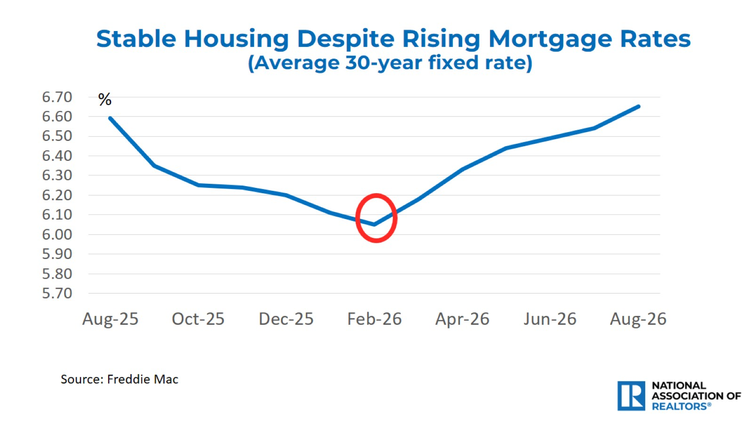

Slide 15
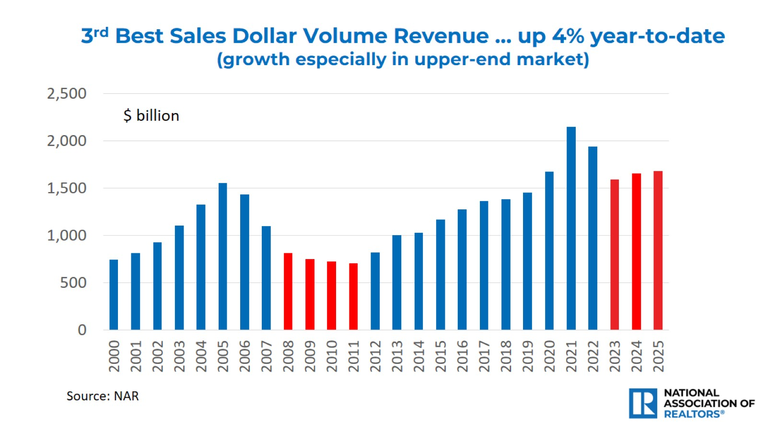

Slide 16
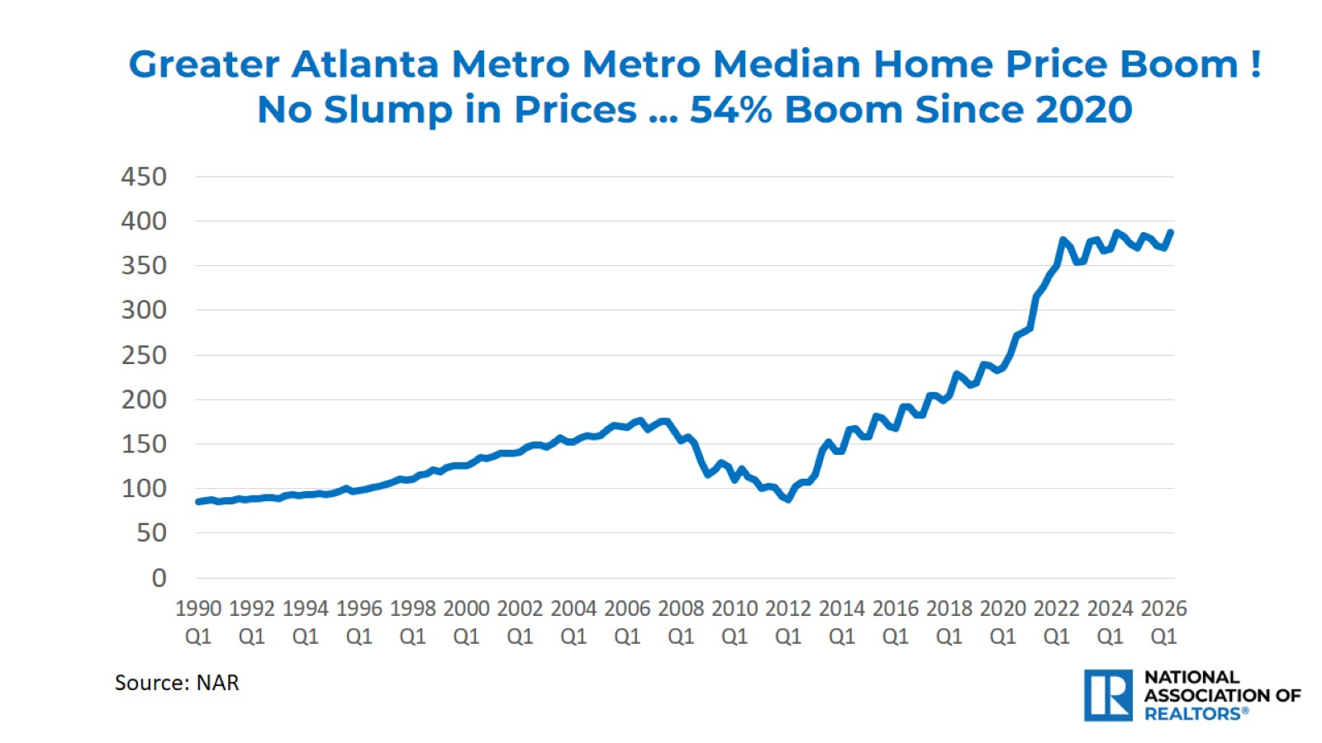

Slide 17
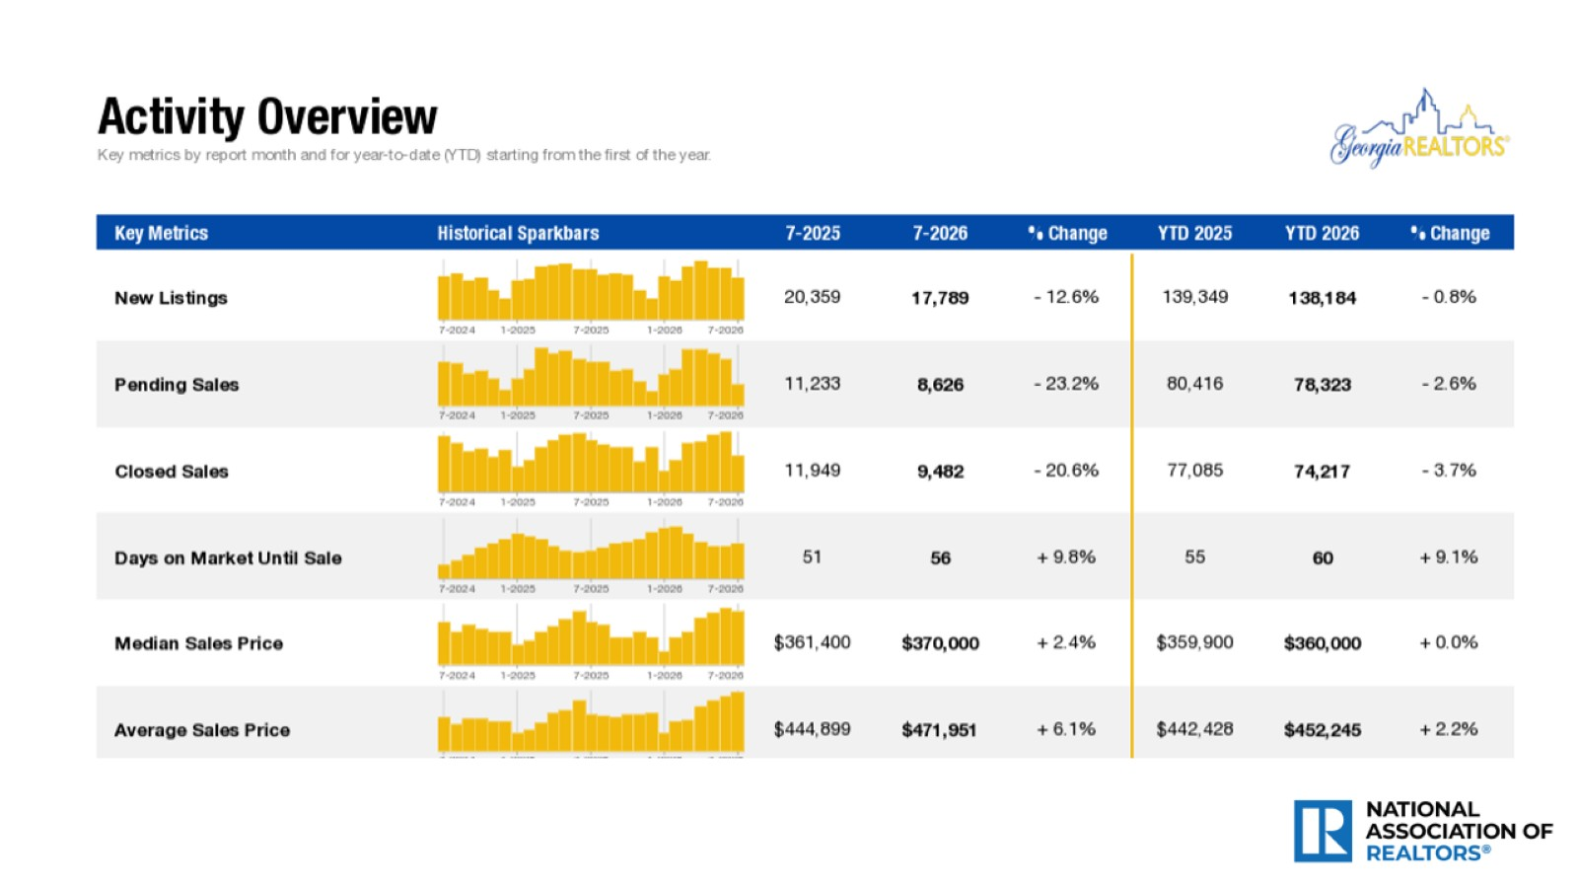

Slide 18
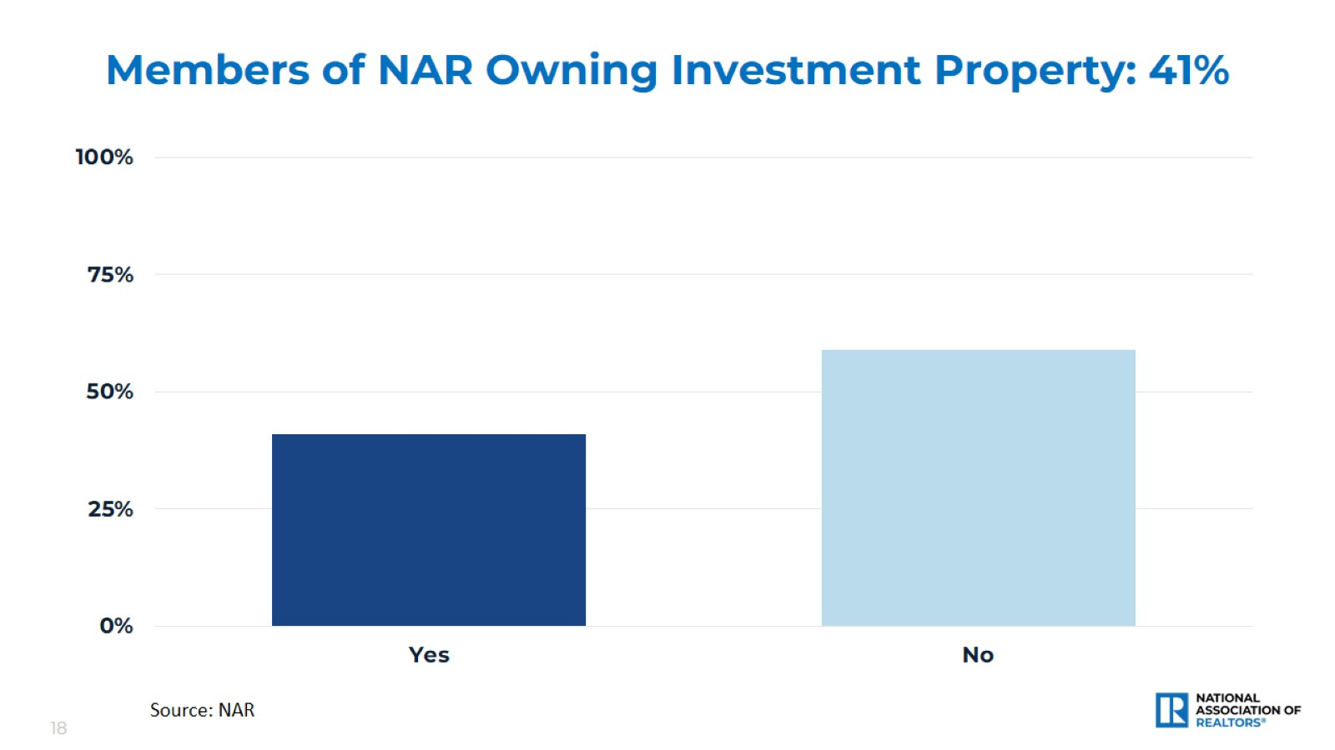
Members of NAR Owning Investment Property: 41%

Slide 19
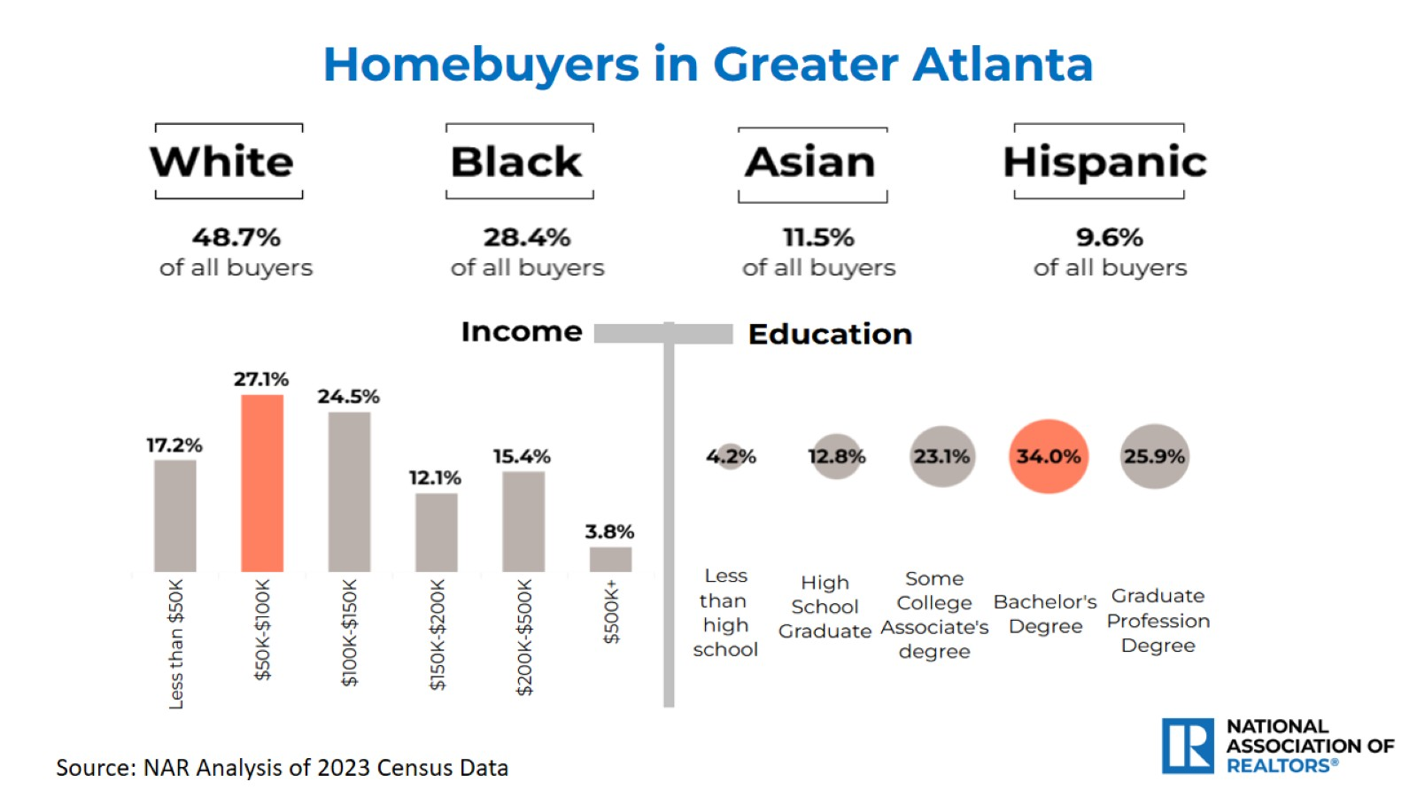
Homebuyers in Greater Atlanta

Slide 20
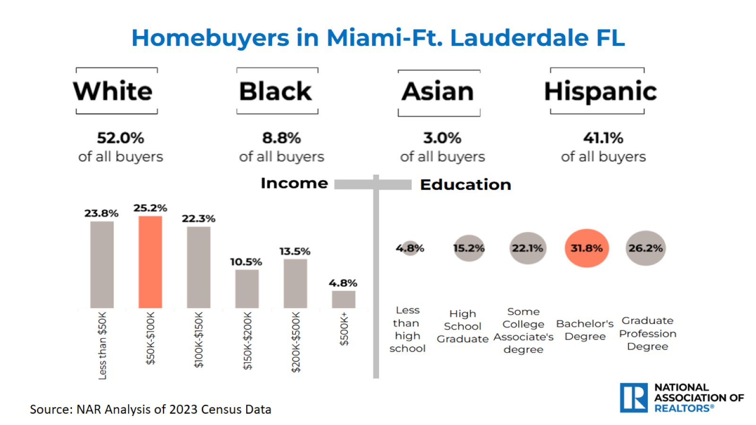
Homebuyers in Miami-Ft. Lauderdale FL

Slide 21
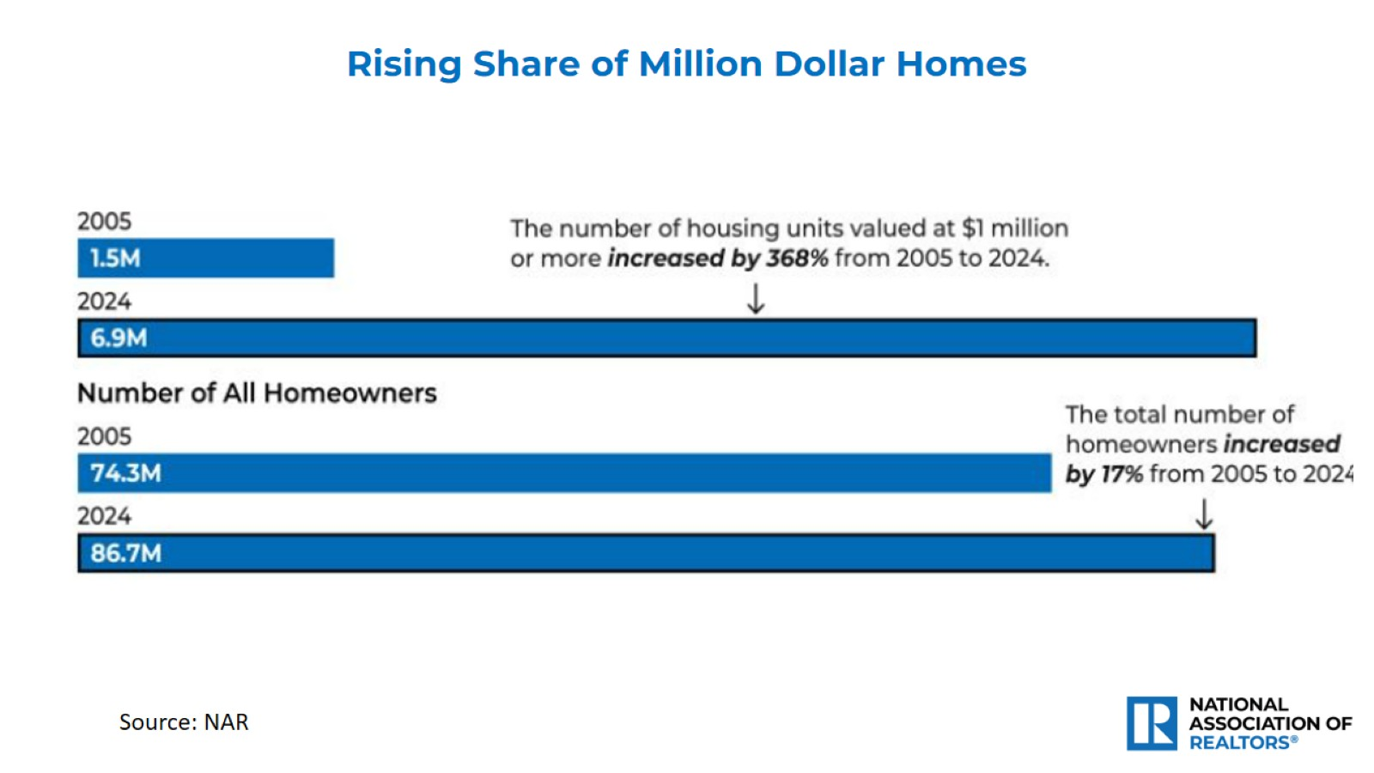

Slide 22
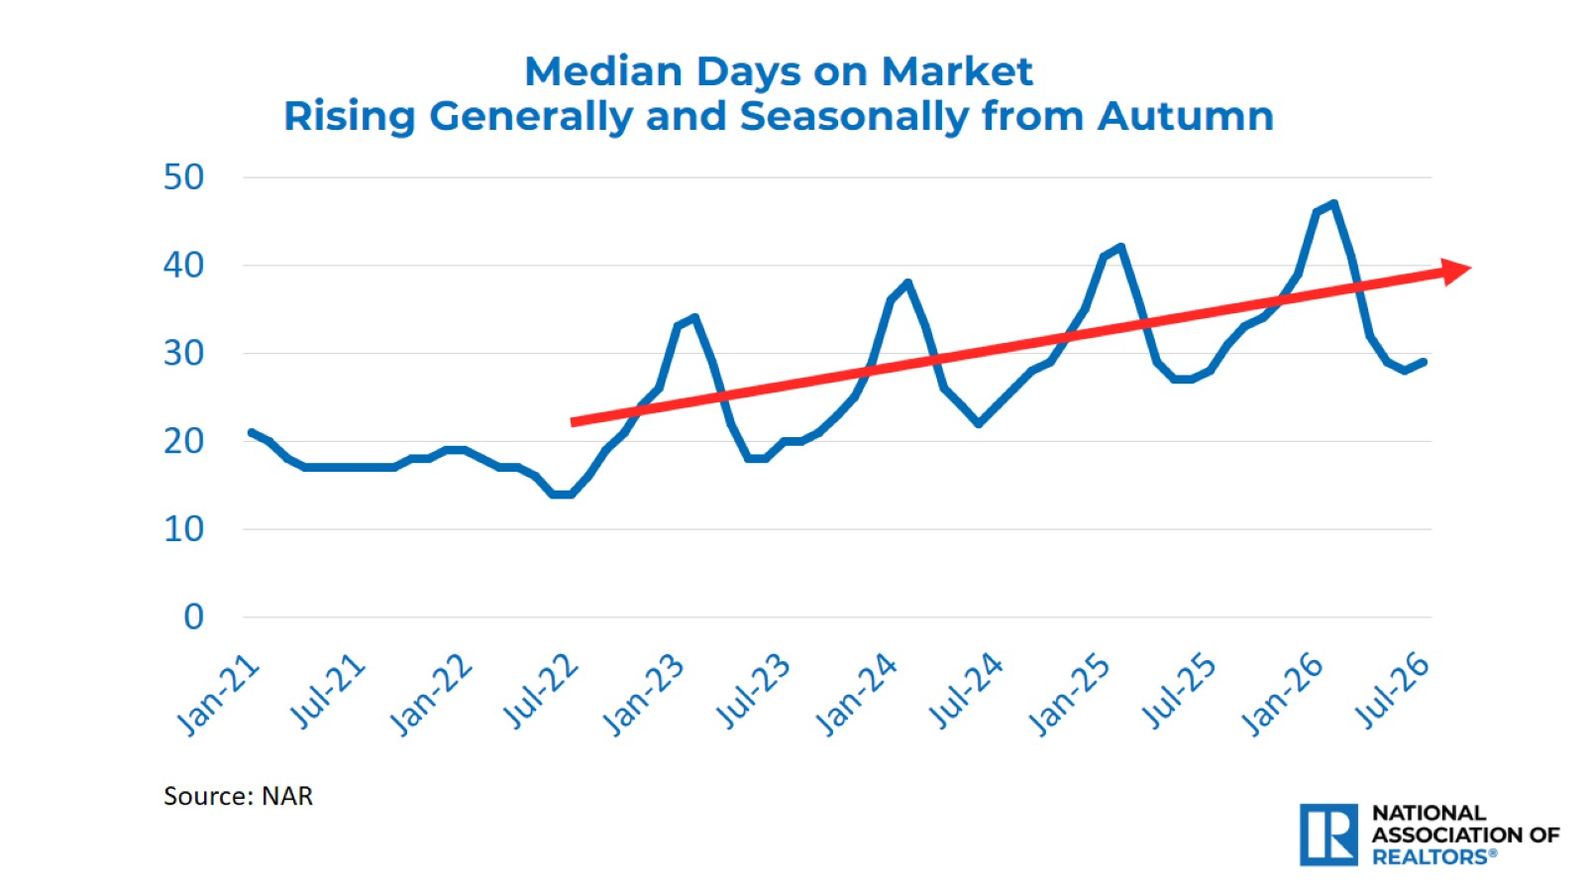

Slide 23
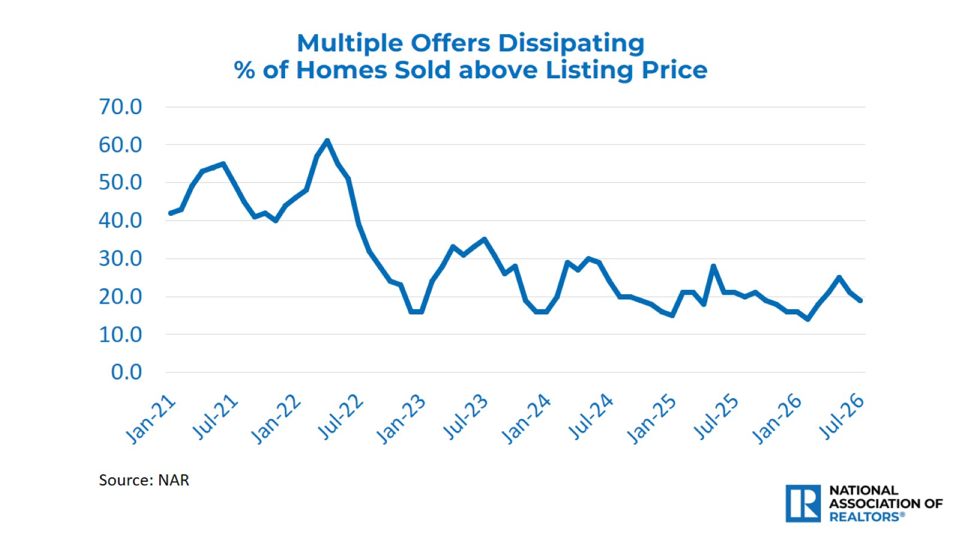

Slide 24
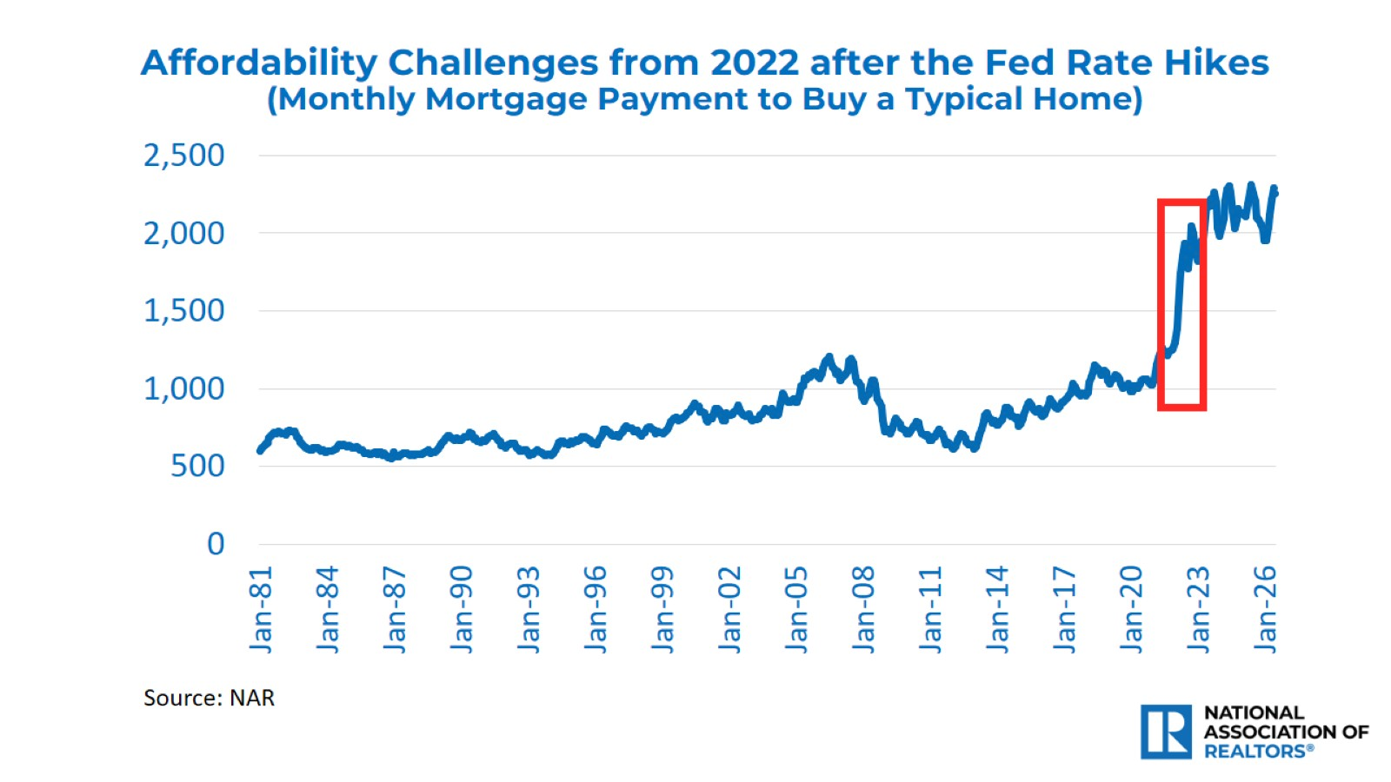

Slide 25
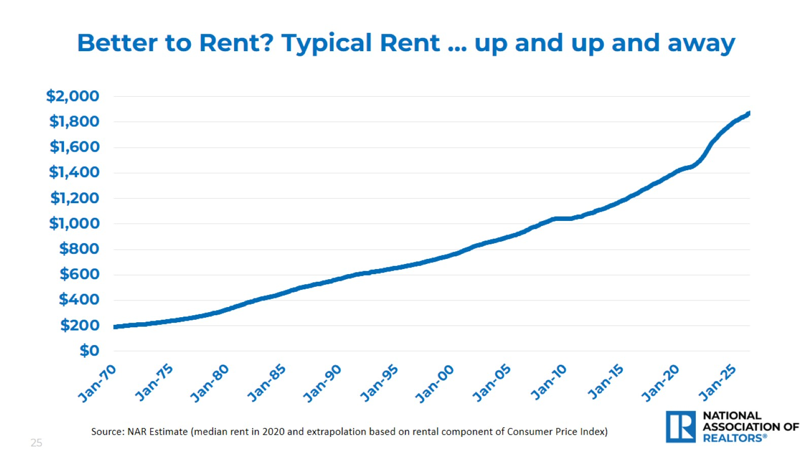
Better to Rent? Typical Rent … up and up and away

Slide 26
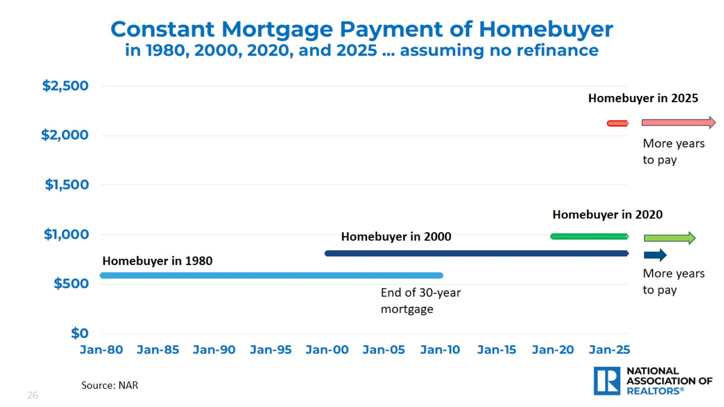
Constant Mortgage Payment of Homebuyer in 1980, 2000, 2020, and 2025 … assuming no refinance

Slide 27
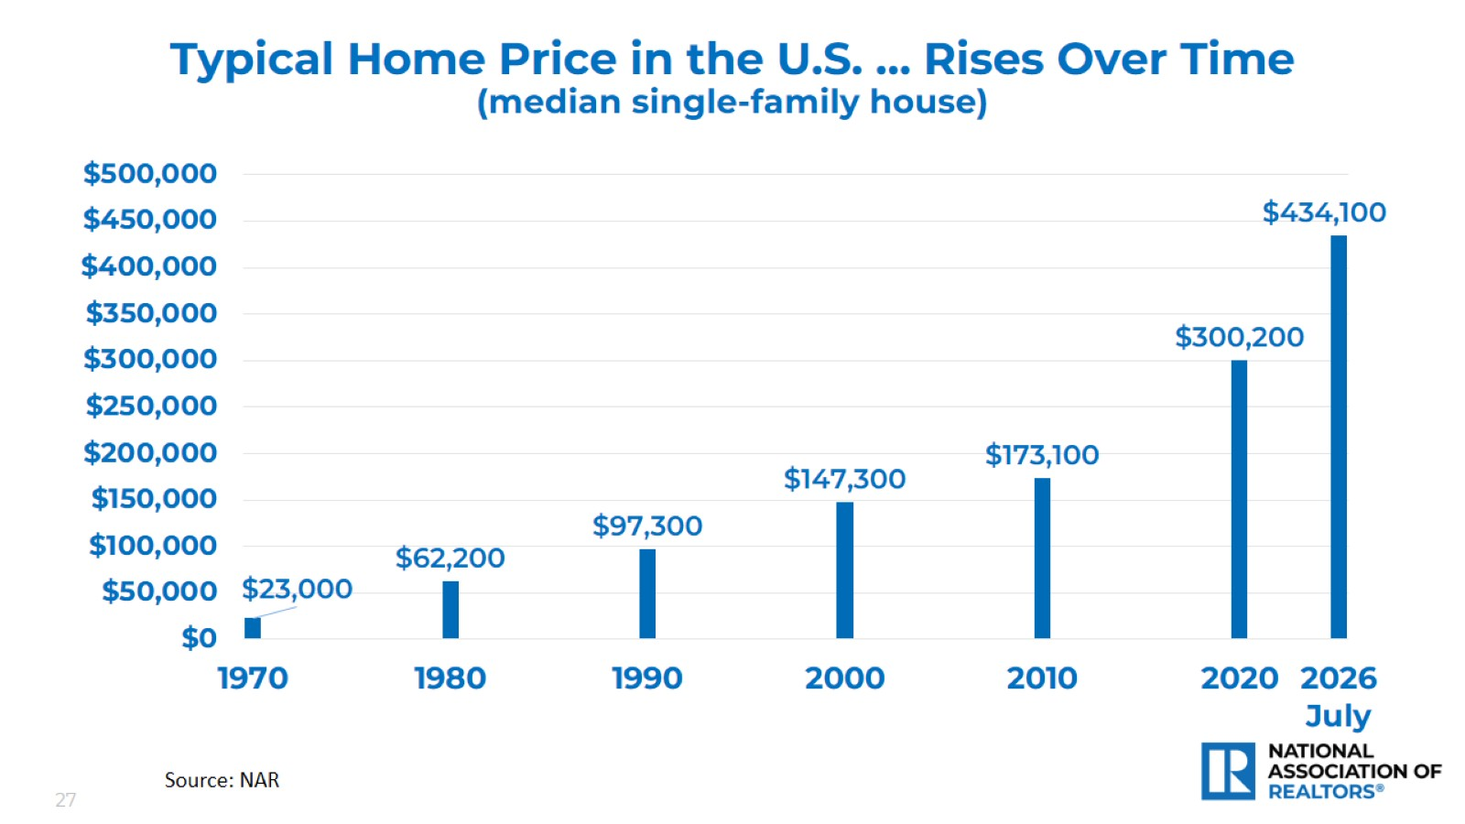
Typical Home Price in the U.S. … Rises Over Time
(median single-family house)

Slide 28
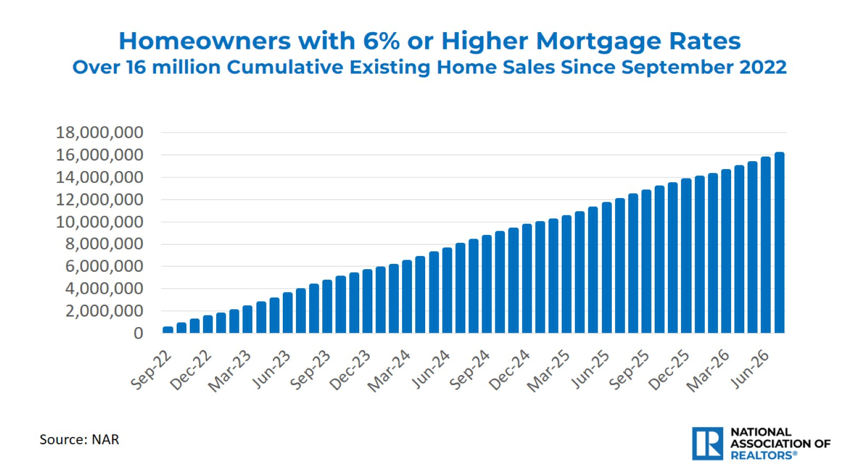

Slide 29

Members of NAR Owning Investment Property: 41%

Slide 30
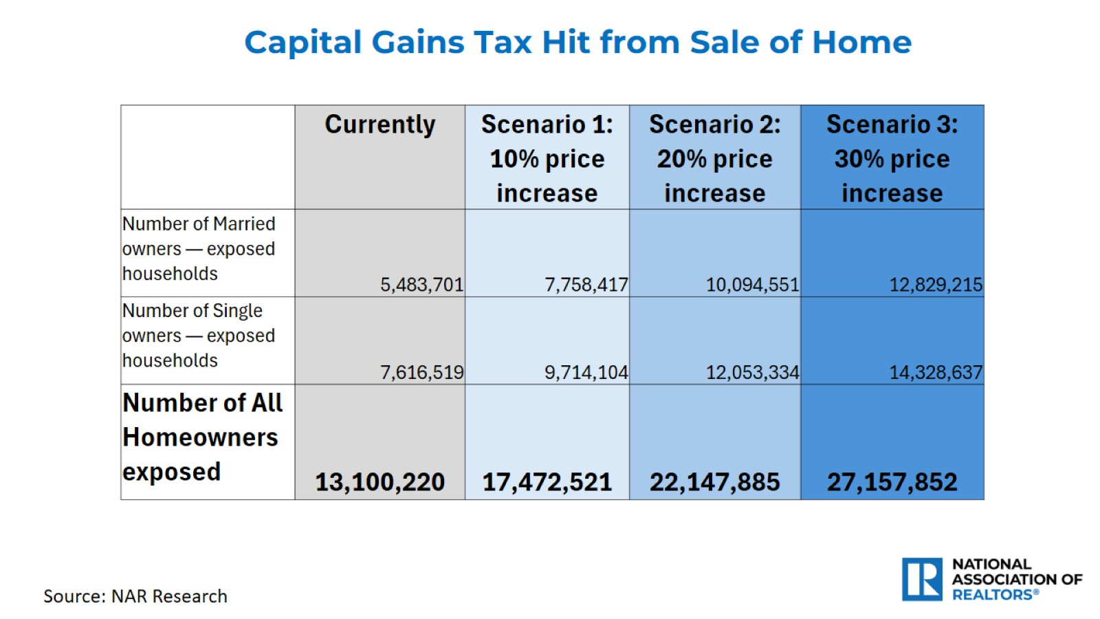

Slide 31


Slide 32
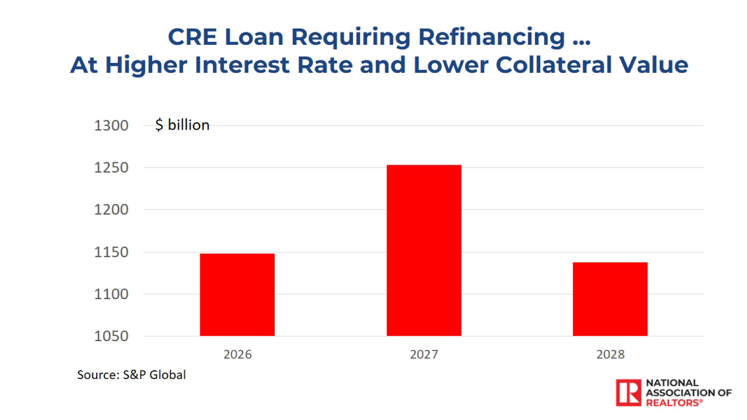

Slide 33
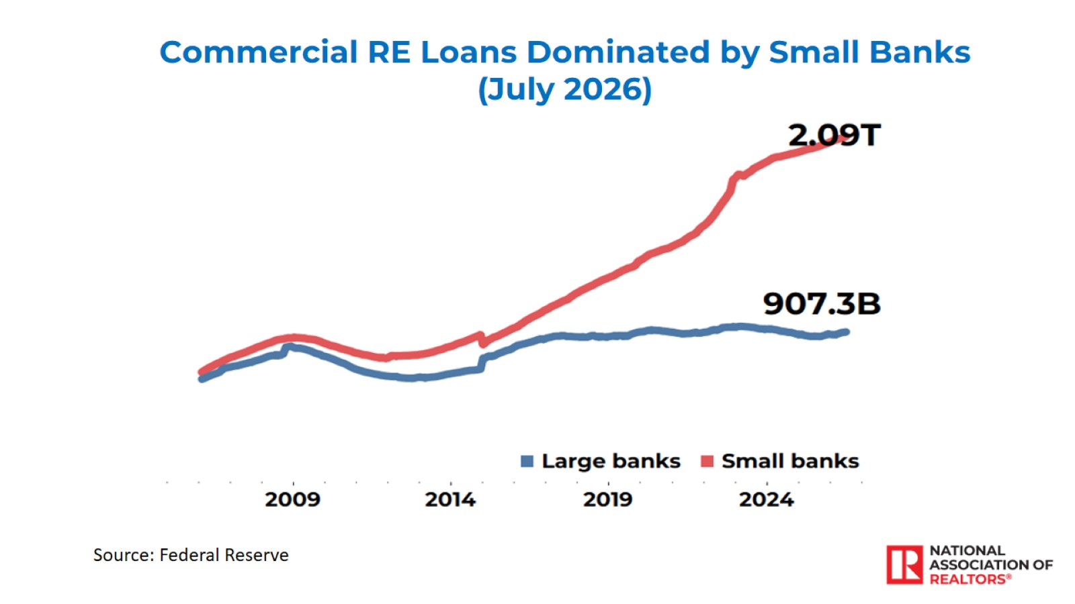

Slide 34
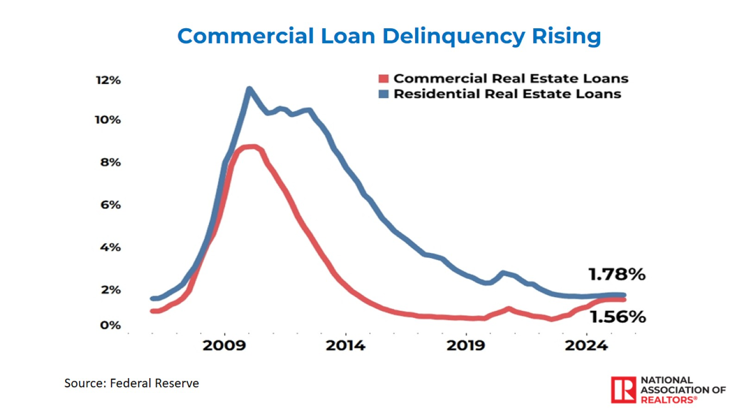

Slide 35
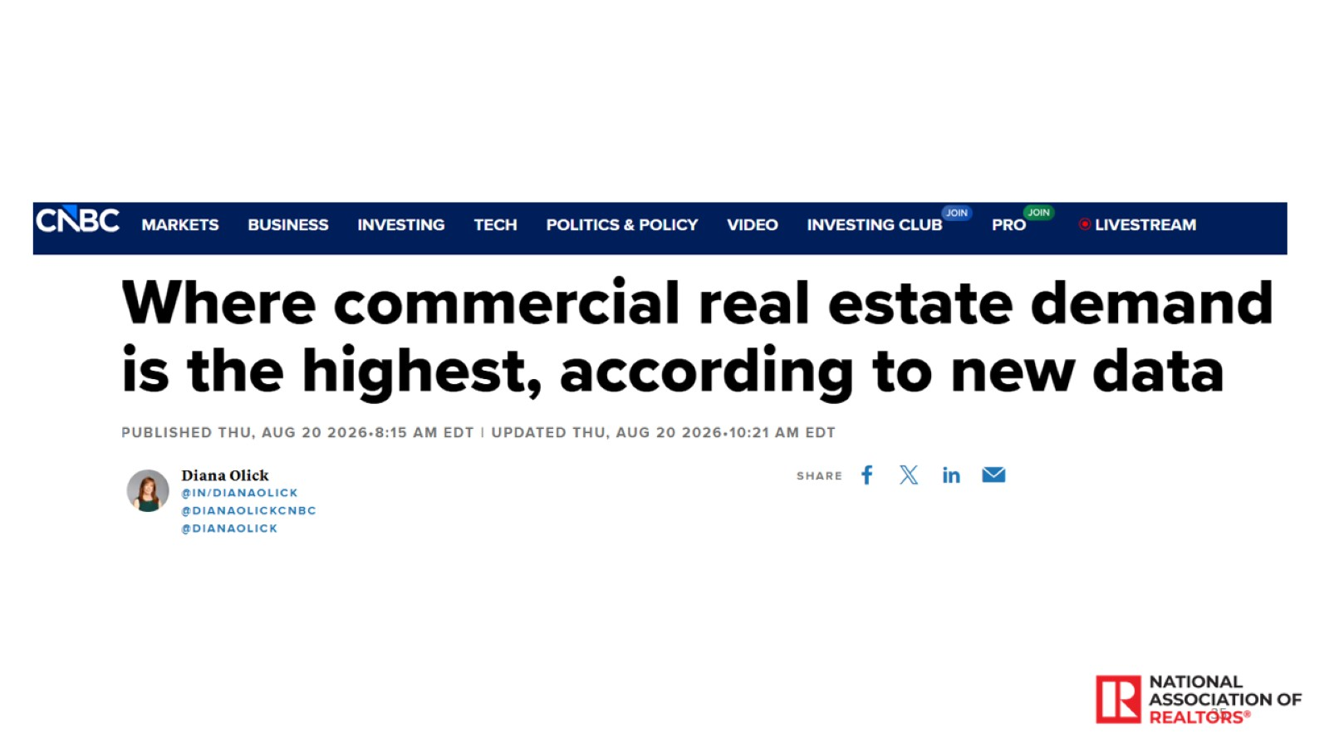

Slide 36
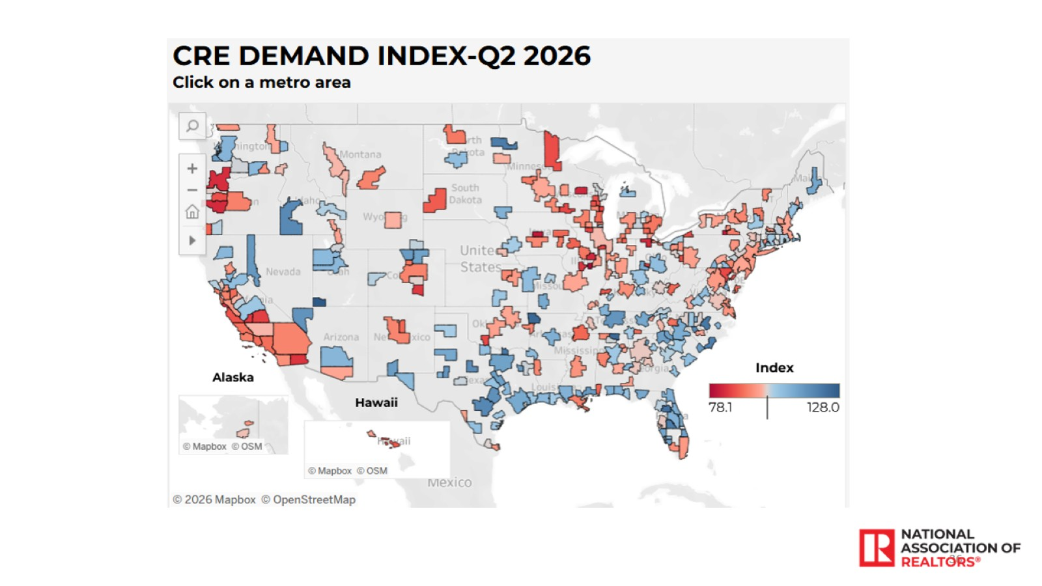

Slide 37
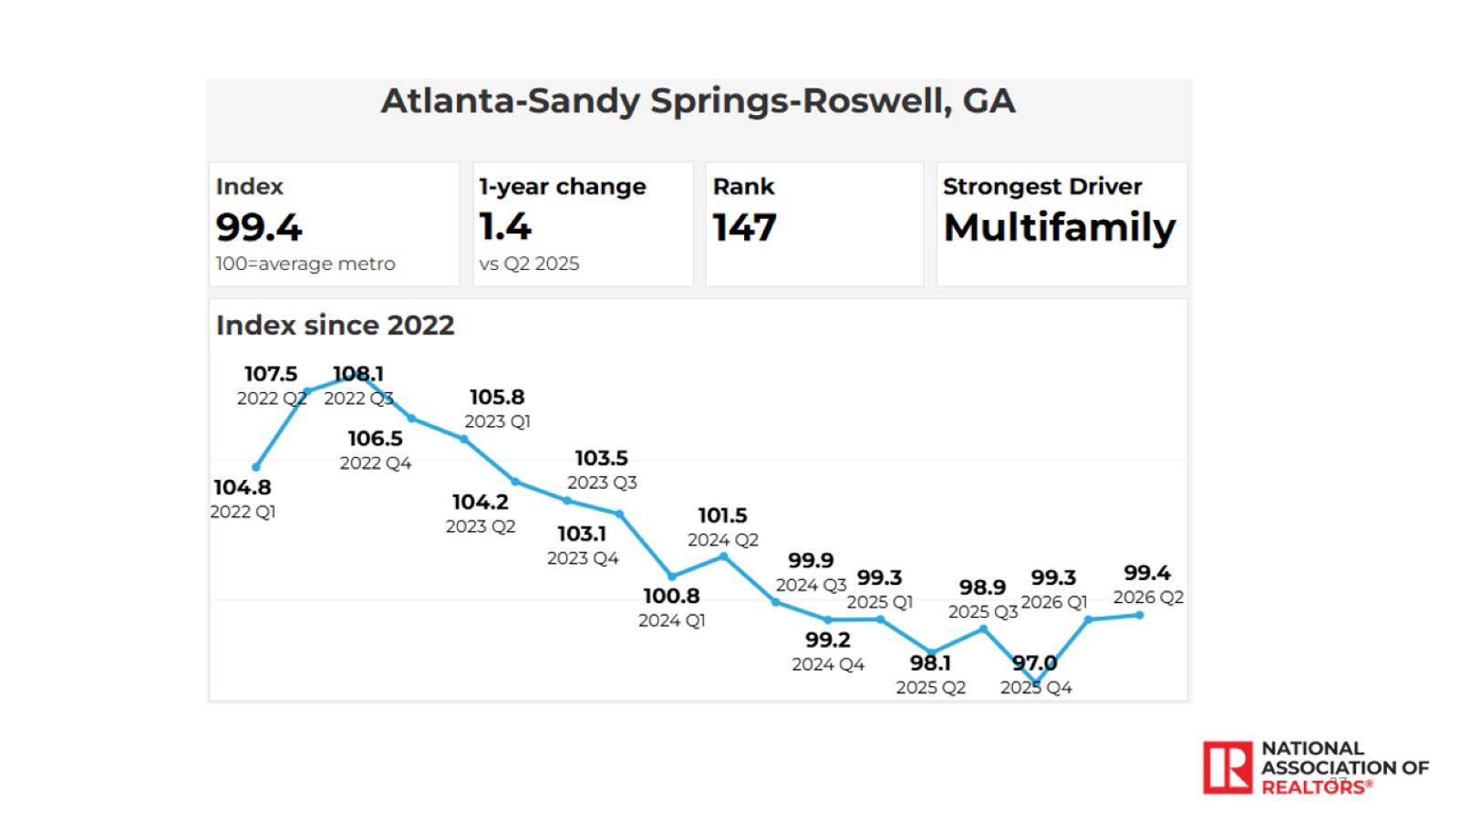

Slide 38
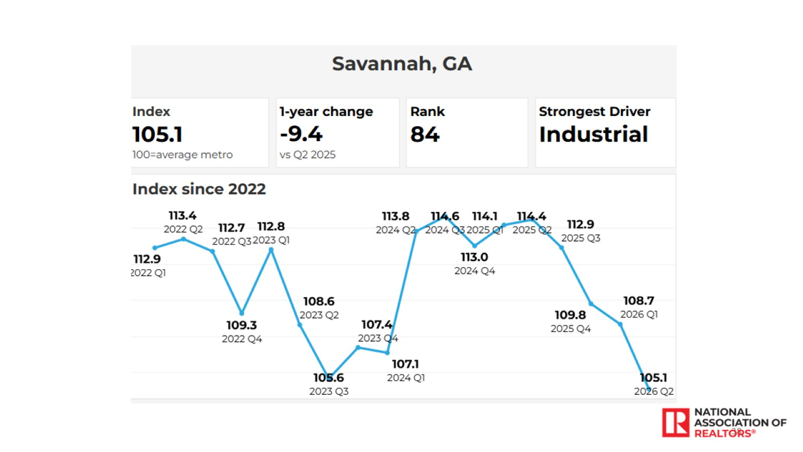

Slide 39
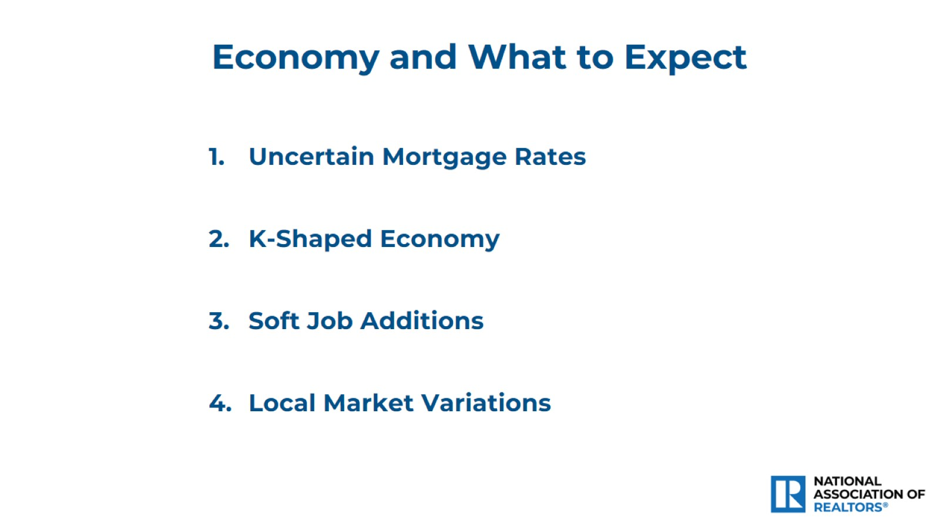

Slide 40
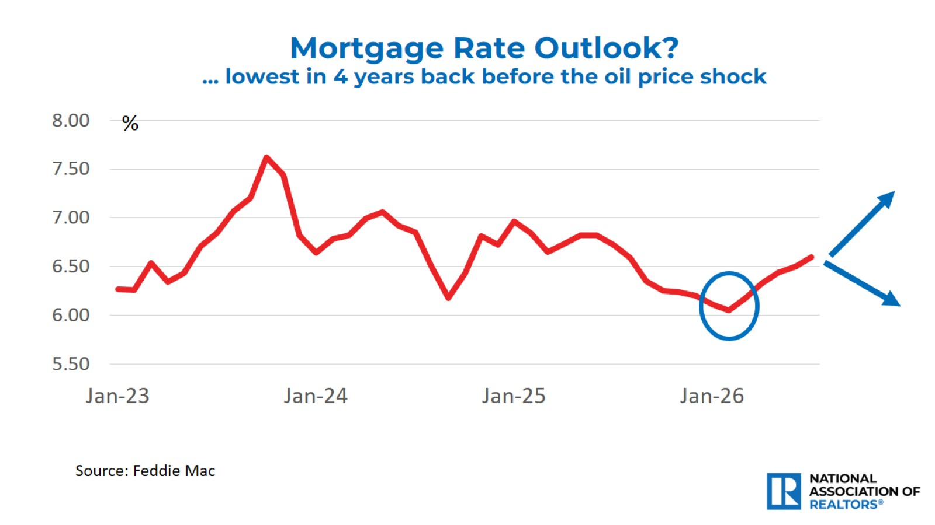

Slide 41
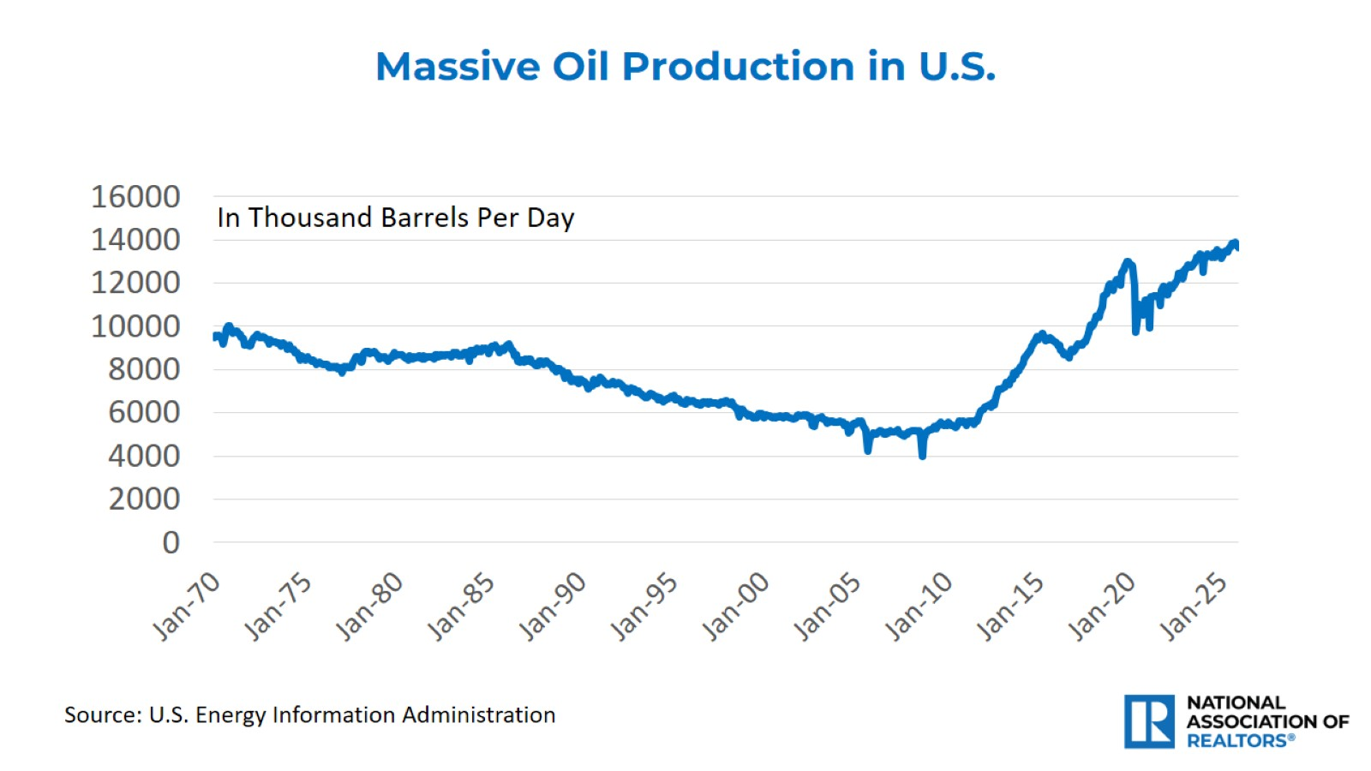

Slide 42
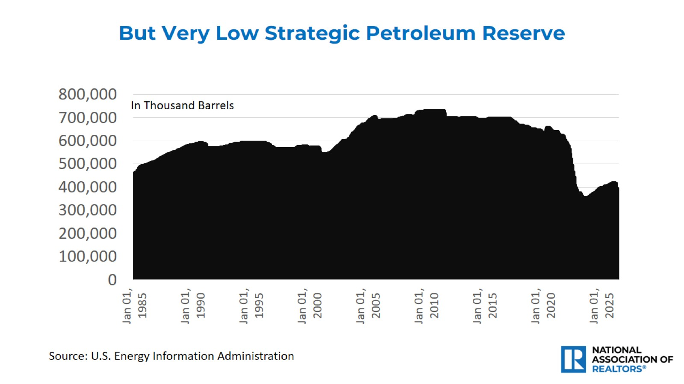

Slide 43
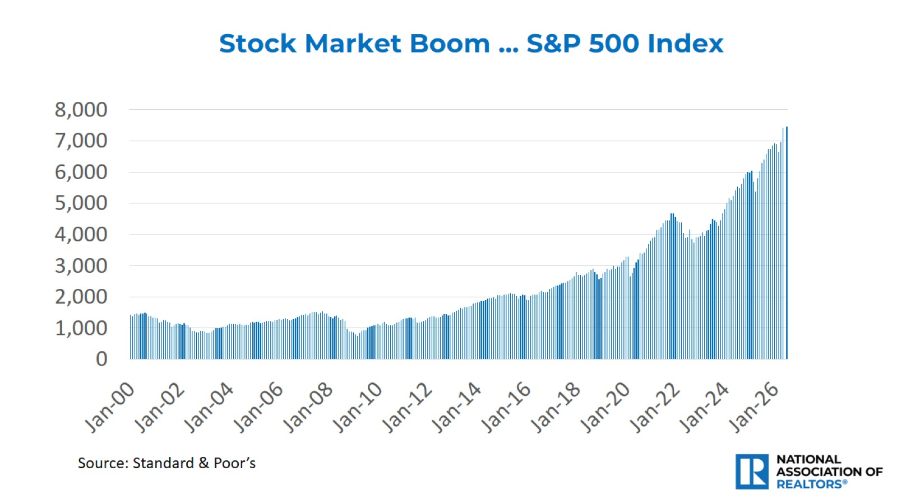

Slide 44
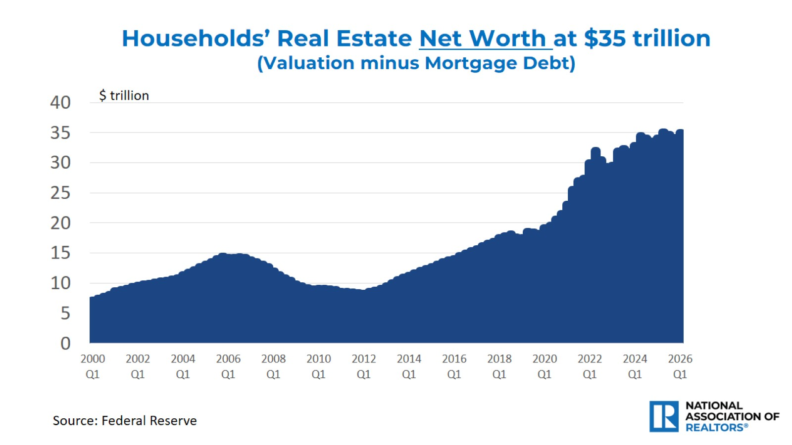

Slide 45
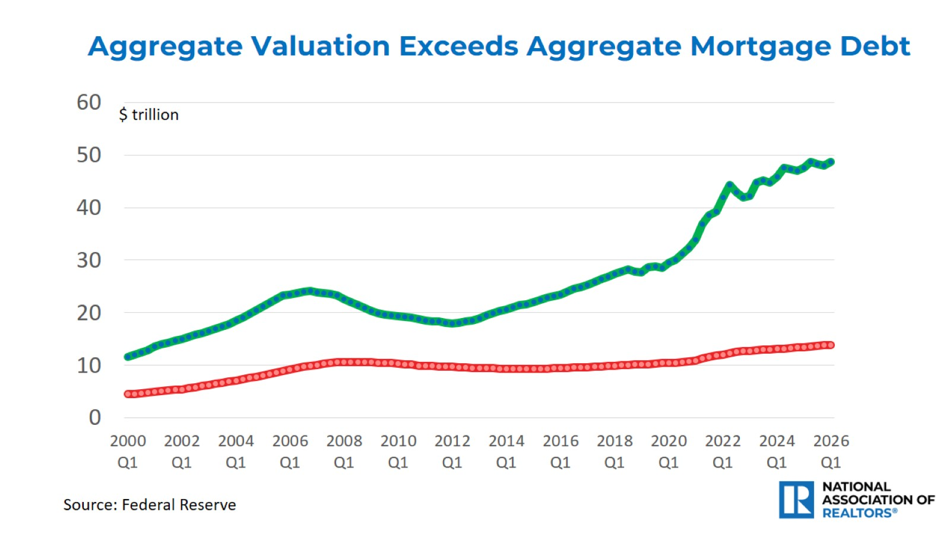

Slide 46
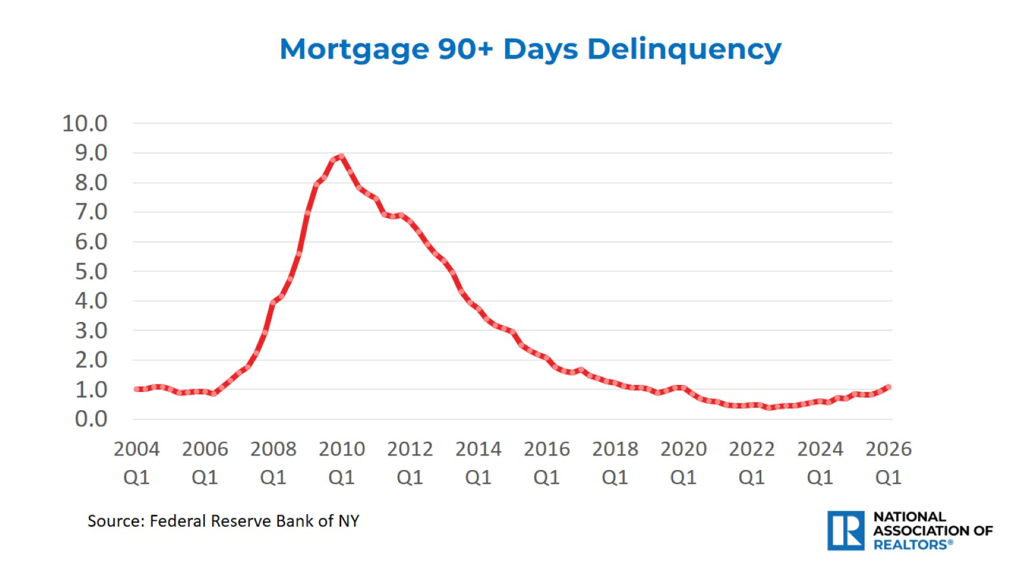

Slide 47
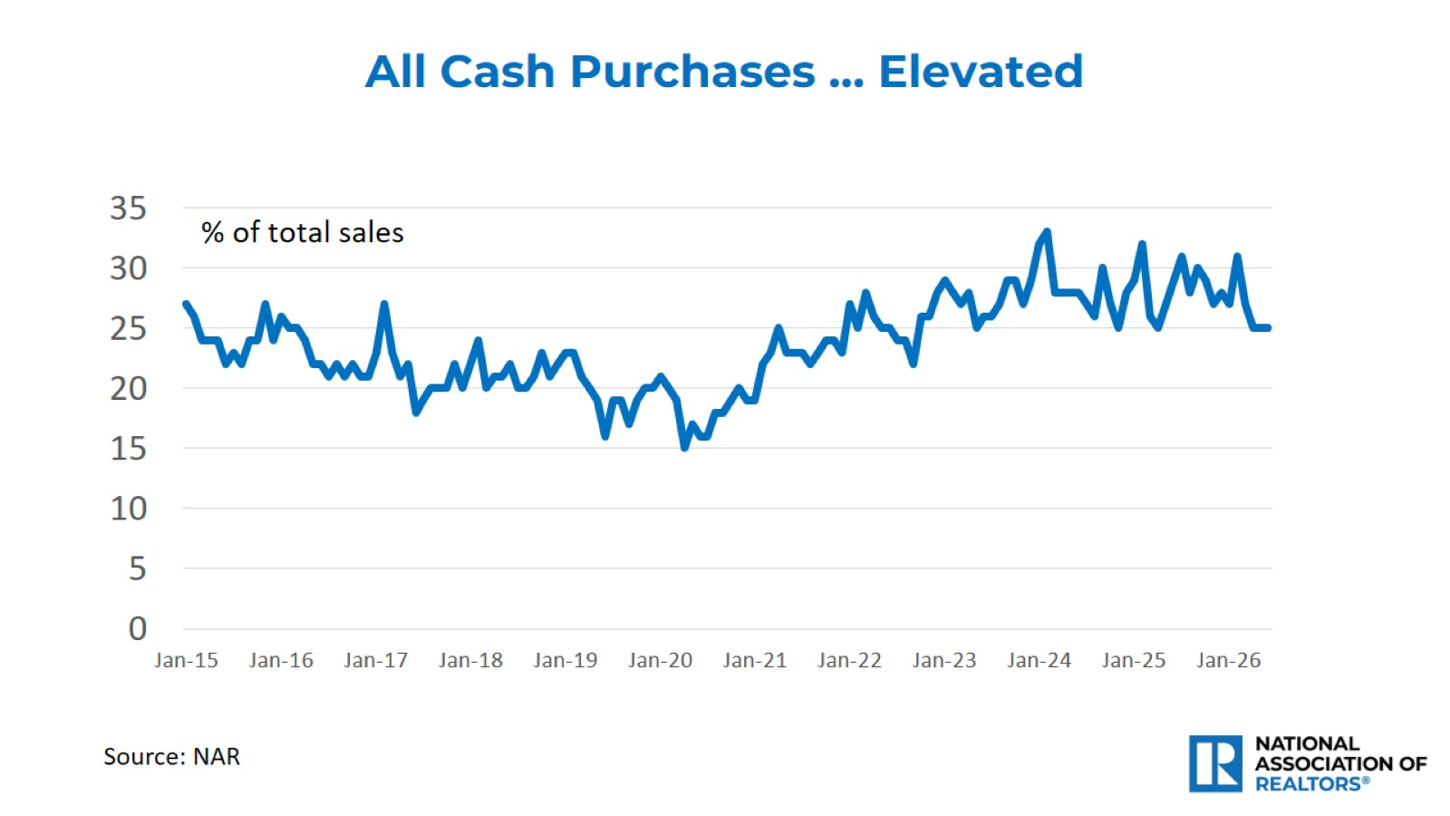

Slide 48
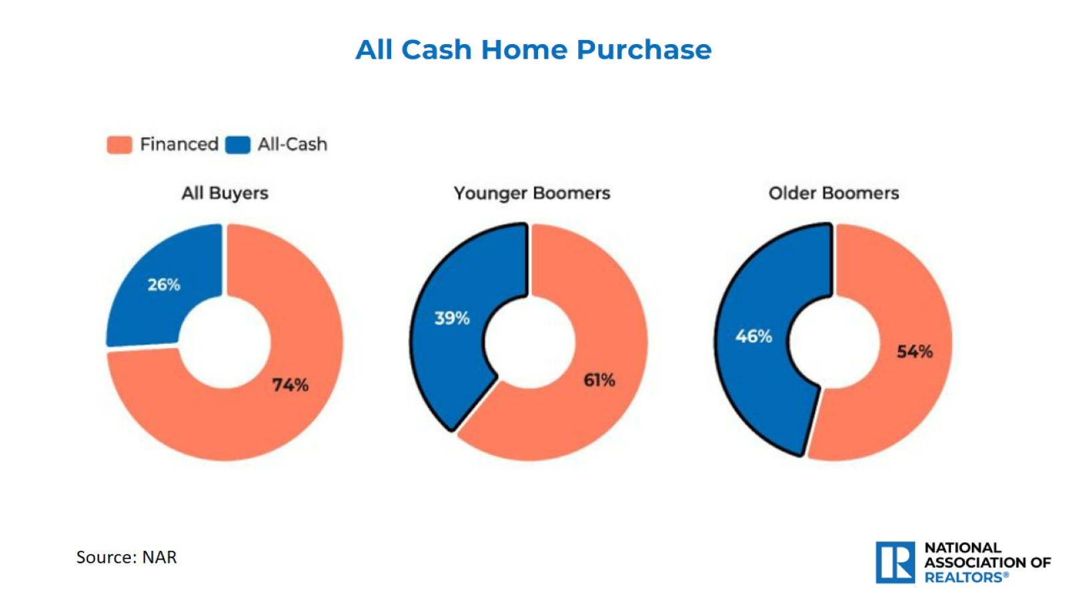

Slide 49
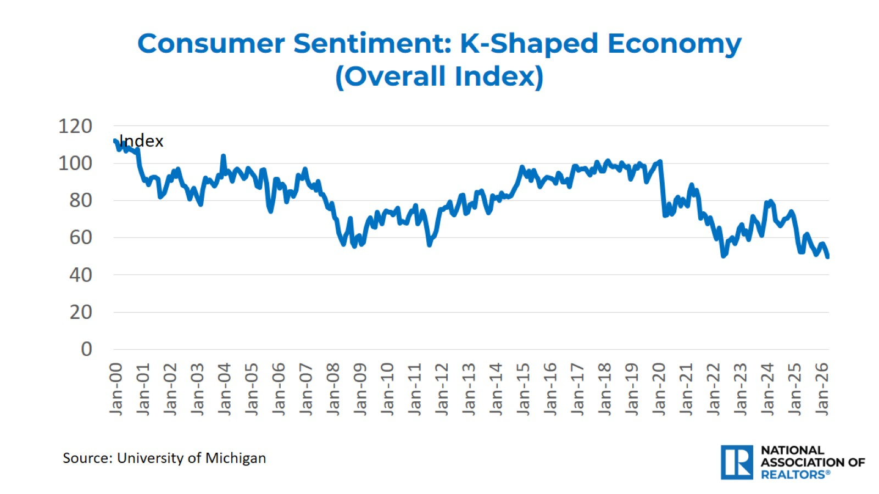

Slide 50
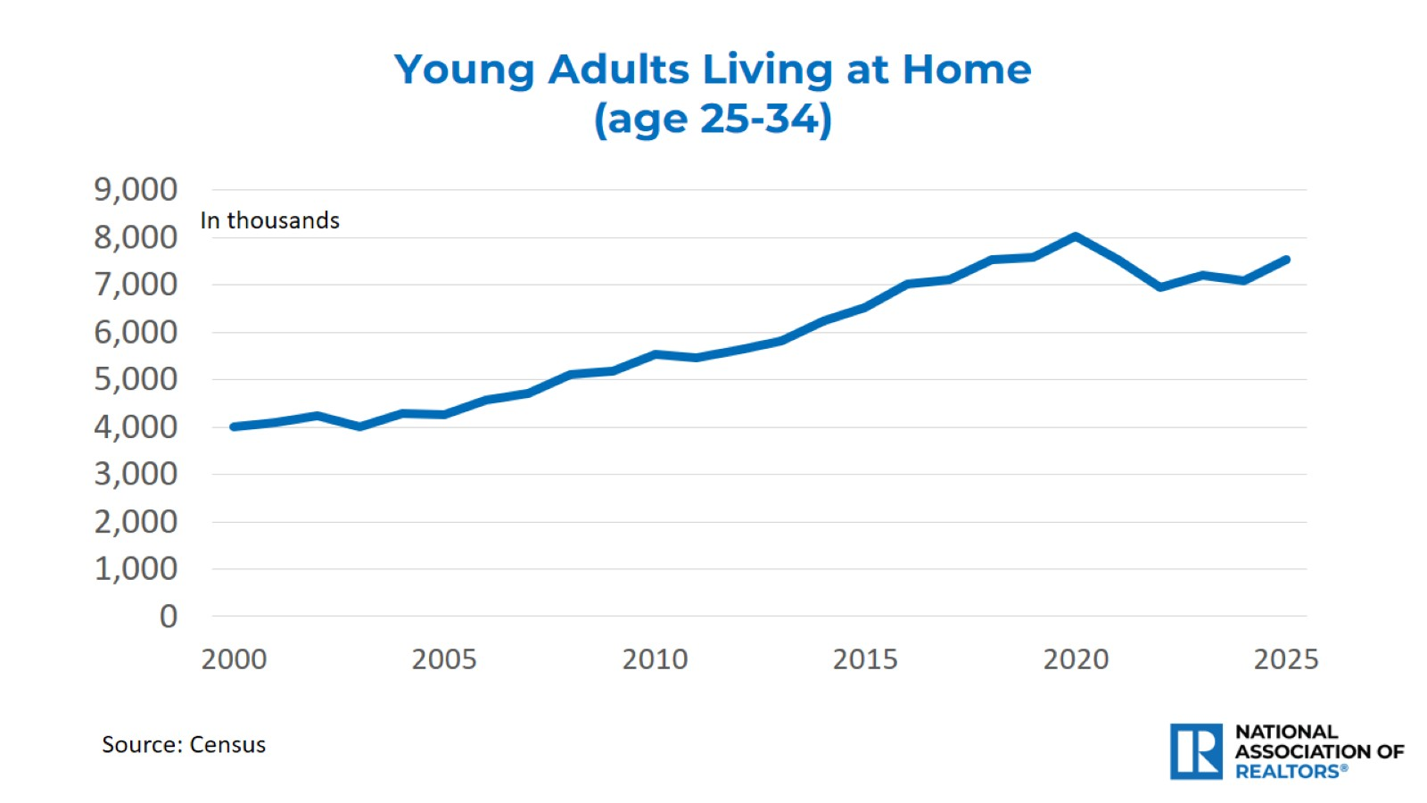

Slide 51
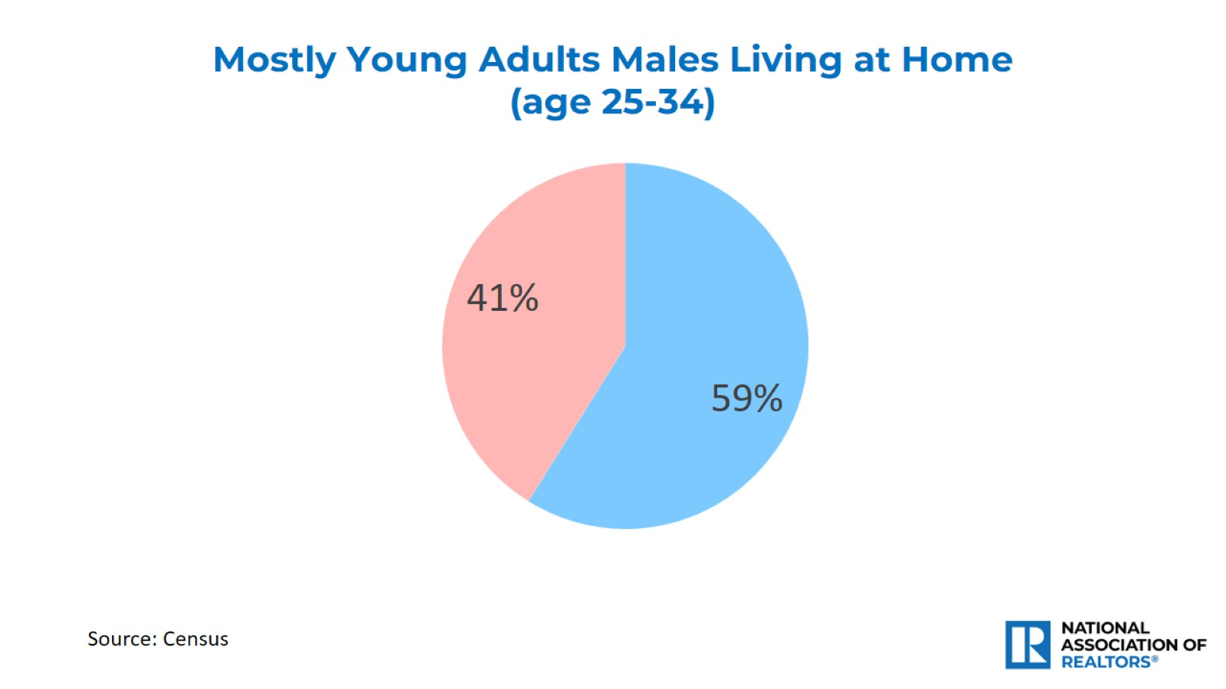

Slide 52
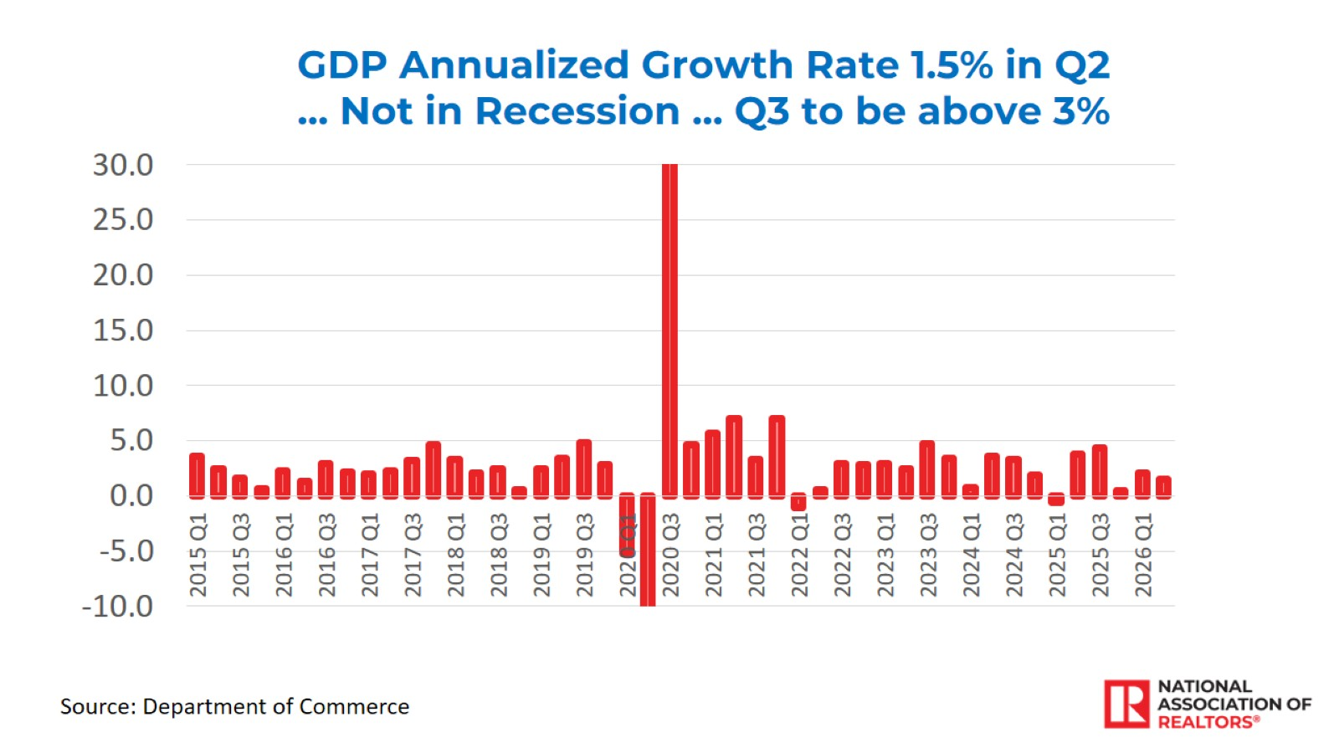

Slide 53
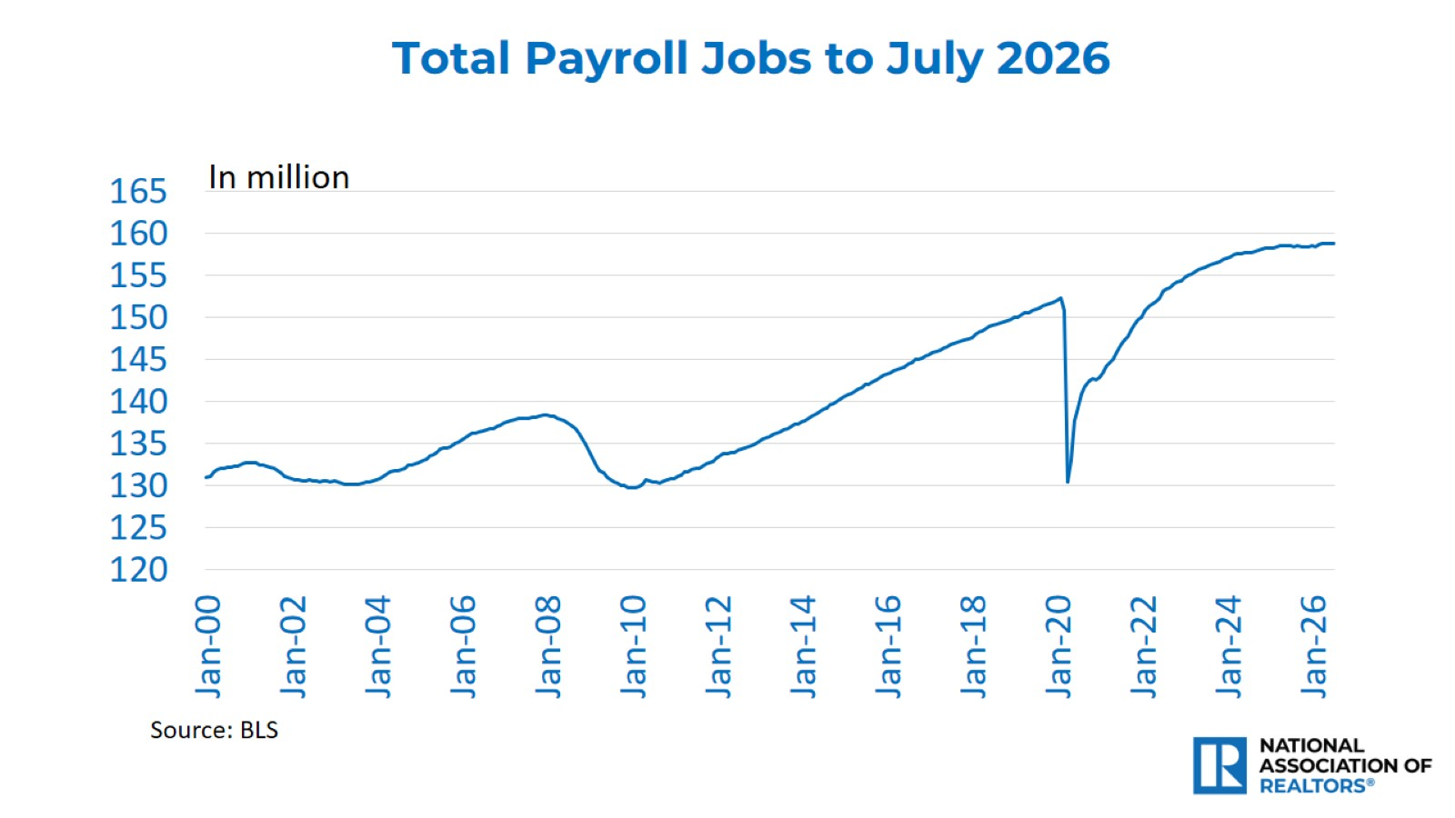

Slide 54


Slide 55


Slide 56


Slide 57


Slide 58

One–year Payroll Job Gain
(% change July 2025 to July 2026)

Slide 59

Job Gains Since Pre-COVID
(% change from March 2020 to July 2026)

Slide 60

Unemployment Rate
(July 2026)

Slide 61


Slide 62


Slide 63


Slide 64


Slide 65


Slide 66


Slide 67


Slide 68

Residential Market Forecast – No Recession

Slide 69


Slide 70


