Slide 1
TACTICAL AWARENESS
The REALTOR® Safety Playbook
SAFETY FIRST. SALE SECOND.
Maurice Taylor, ARB, CRS, CRB, DREI, GSI
TACTICAL AWARENESS • REALTOR® SAFETY PLAYBOOK 01

Slide 2
COURSE OBJECTIVE
Mission Brief
Your best asset isn't your listing — it's your life.
Recognize warning signs before they escalate.
Use situational awareness during showings and open houses.
Create repeatable safety protocols for yourself, your office, and your clients.
Leave with a personalized 24-hour safety action plan.
TACTICAL AWARENESS • REALTOR® SAFETY PLAYBOOK 02

Slide 3
COURSE FLOW
90-Minute Operational Timeline
00:00–00:15
MISSION & MINDSET
15 MIN
00:15–00:38
INTEL / PRE-SCREENING
23 MIN
00:38–01:08
FIELD OPERATIONS
30 MIN
01:08–01:23
DISTRESS PROTOCOL
15 MIN
01:23–01:30
Q&A / SAFETY PLEDGE
7 MIN
TACTICAL AWARENESS • REALTOR® SAFETY PLAYBOOK 03

Slide 4
00:00–00:15
The Mission & The Mindset
PASSIVE
→
PROACTIVE
Safety is not fear. It is awareness, preparation, and procedure.
Professionalism never requires sacrificing personal safety.
An appointment can be rescheduled.
A commission can be replaced.
The goal: not suspicious of everyone, it’s aware of everything.
TACTICAL AWARENESS • REALTOR® SAFETY PLAYBOOK 04

Slide 5
SITUATIONAL AWARENESS EXERCISE
Looking Is Not Observing
When you arrived today… what did you notice?
Where did you park?
Who was nearby?
Which vehicles were occupied or running?
Where were the nearest exits?
What changed between arrival and now?
SITUATIONAL
AWARENESS
TACTICAL AWARENESS • REALTOR® SAFETY PLAYBOOK 05

Slide 6
SITUATIONAL AWARENESS EXERCISE
Looking Is Not Observing
When you arrived today… what did you notice?
AWARENESS
BUYS TIME
TIME
CREATES OPTIONS
TACTICAL AWARENESS • REALTOR® SAFETY PLAYBOOK 05

Slide 7
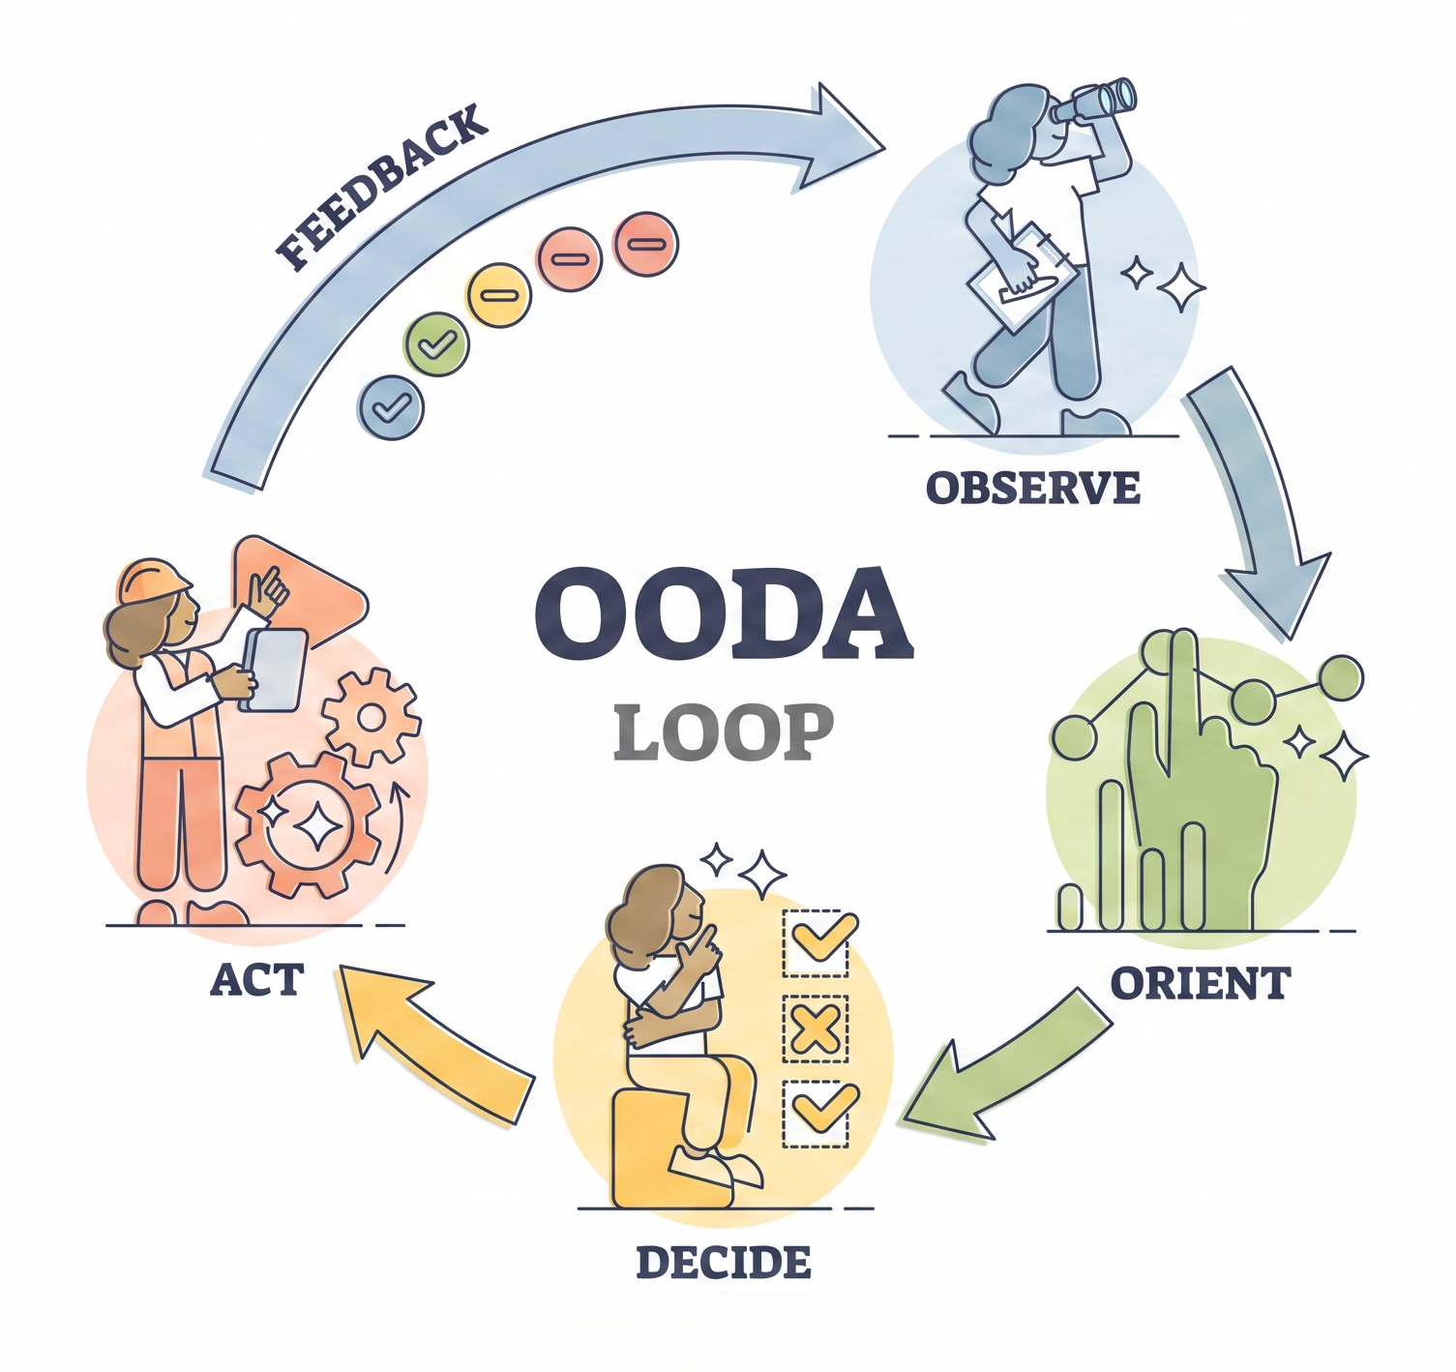
TACTICAL DECISION-MAKING
THE OODA LOOP
Safety is a continuous cycle of observation — not a one-time checklist.
TACTICAL AWARENESS • THE REALTOR® SAFETY PLAYBOOK

Slide 8
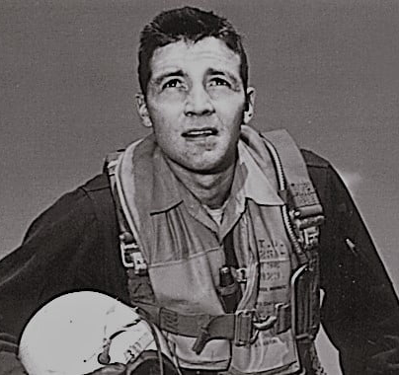
TACTICAL DECISION-MAKING
THE OODA LOOP
JOHN BOYD
Safety is a continuous cycle of observation — not a one-time checklist.
TACTICAL AWARENESS • THE REALTOR® SAFETY PLAYBOOK

Slide 9
TACTICAL DECISION-MAKING
THE OODA LOOP
OBSERVE
What is happening?
ORIENT
What does it mean here?
What is happening?
DECIDE
What is my safest option?
ACT
Move — then reassess.
OBSERVE • ORIENT • DECIDE • ACT
Safety is a continuous cycle of observation — not a one-time checklist.
TACTICAL AWARENESS • THE REALTOR® SAFETY PLAYBOOK

Slide 10
TACTICAL DECISION-MAKING
THE OODA LOOP
OBSERVE
What is happening?
ORIENT
What does it mean here?
DECIDE
What is my safest option?
ACT
Move — then reassess.
OBSERVE • ORIENT • DECIDE • ACT
Safety is a continuous cycle of observation — not a one-time checklist.
TACTICAL AWARENESS • THE REALTOR® SAFETY PLAYBOOK

Slide 11
TACTICAL DECISION-MAKING
THE OODA LOOP
OBSERVE
What is happening?
ORIENT
What does it mean here?
What is my safest option?
DECIDE
ACT
Move — then reassess.
OBSERVE • ORIENT • DECIDE • ACT
Safety is a continuous cycle of observation — not a one-time checklist.
TACTICAL AWARENESS • THE REALTOR® SAFETY PLAYBOOK

Slide 12
TACTICAL DECISION-MAKING
THE OODA LOOP
OBSERVE
What is happening?
ORIENT
What does it mean here?
Move — then reassess.
DECIDE
What is my safest option?
ACT
OBSERVE • ORIENT • DECIDE • ACT
Safety is a continuous cycle of observation — not a one-time checklist.
TACTICAL AWARENESS • THE REALTOR® SAFETY PLAYBOOK

Slide 13
OBSERVE • ORIENT • DECIDE • ACT
OODA Loop
OBSERVE
ACT
ORIENT
DECIDE
Continuous cycle — not a one-time checklist.
TACTICAL AWARENESS • REALTOR® SAFETY PLAYBOOK 06

Slide 14
OBSERVE • ORIENT • DECIDE • ACT
OODA Loop
OBSERVE
Gather fresh data from your surroundings and the current situation.
Continuous cycle — not a one-time checklist.
TACTICAL AWARENESS • REALTOR® SAFETY PLAYBOOK 06

Slide 15
OBSERVE • ORIENT • DECIDE • ACT
OODA Loop
Review the data using your background, culture, and past experiences to make sense of it.
ORIENT
Continuous cycle — not a one-time checklist.
TACTICAL AWARENESS • REALTOR® SAFETY PLAYBOOK 06

Slide 16
OBSERVE • ORIENT • DECIDE • ACT
OODA Loop
Pick the best plan or choice based on your orientation.
DECIDE
Continuous cycle — not a one-time checklist.
TACTICAL AWARENESS • REALTOR® SAFETY PLAYBOOK 06

Slide 17
OBSERVE • ORIENT • DECIDE • ACT
OODA Loop
Carry out your choice and see what results happen.
ACT
Continuous cycle — not a one-time checklist.
TACTICAL AWARENESS • REALTOR® SAFETY PLAYBOOK 06

Slide 18
OBSERVE • ORIENT • DECIDE • ACT
OODA Loop
OBSERVE
Safety is a continuous cycle of observation
rather than a one-time checklist.
ACT
ORIENT
DECIDE
TACTICAL AWARENESS • REALTOR® SAFETY PLAYBOOK 06

Slide 19
OBSERVE • ORIENT • DECIDE • ACT
OODA Loop
OBSERVE
ORIENT
ACT
DECIDE
Continuous cycle — not a one-time checklist.
TACTICAL AWARENESS • REALTOR® SAFETY PLAYBOOK 06

Slide 20
OBSERVE • ORIENT • DECIDE • ACT
OODA Loop
Continuous cycle — not a one-time checklist.
TACTICAL AWARENESS • REALTOR® SAFETY PLAYBOOK 06

Slide 21
00:15–00:38
The "Intel" Phase: Pre-Screening
ANONYMITY + ISOLATION
= INCREASED RISK
Safety begins before you arrive at the property.
Verify identity and contact information.
Notice inconsistencies, pressure, and attempts to isolate you.
Use an Office First rule for unknown prospects whenever practical.
Create a record of who you are meeting and where.
VERIFY • DOCUMENT • SHARE
TACTICAL AWARENESS • REALTOR® SAFETY PLAYBOOK 07

Slide 22
INTEL CHECKLIST
Initial Contact: Red Flags
ONE ODD DETAIL ≠ DANGER
Refuses reasonable identifying information.
Insists on meeting alone at a vacant or isolated property.
Becomes angry about normal safety procedures.
Asks whether you will be alone.
Changes details or provides inconsistent information.
Pressures you to abandon your normal process.
LOOK FOR PATTERNS,
ESCALATION & ISOLATION
TACTICAL AWARENESS • REALTOR® SAFETY PLAYBOOK 08

Slide 23
FILE A “FLIGHT PLAN”
Command Center Protocol
Someone should always know…
WHO
Who you are meeting
WHERE
Where you are going
WHEN
Arrival and expected finish
NEXT
Where you go afterward
TRIGGER
When to act if you miss check-in
TACTICAL AWARENESS • REALTOR® SAFETY PLAYBOOK 09

Slide 24
FILE A “FLIGHT PLAN”
Command Center Protocol
Someone should always know…
WHO
Who you are meeting
TACTICAL AWARENESS • REALTOR® SAFETY PLAYBOOK 09

Slide 25
FILE A “FLIGHT PLAN”
Command Center Protocol
Someone should always know…
WHERE
Where you are going
TACTICAL AWARENESS • REALTOR® SAFETY PLAYBOOK 09

Slide 26
FILE A “FLIGHT PLAN”
Command Center Protocol
Someone should always know…
WHEN
Arrival and expected finish
TACTICAL AWARENESS • REALTOR® SAFETY PLAYBOOK 09

Slide 27
FILE A “FLIGHT PLAN”
Command Center Protocol
Someone should always know…
NEXT
Where you go afterward
TACTICAL AWARENESS • REALTOR® SAFETY PLAYBOOK 09

Slide 28
FILE A “FLIGHT PLAN”
Command Center Protocol
Someone should always know…
TRIGGER
When to act if you miss check-in
TACTICAL AWARENESS • REALTOR® SAFETY PLAYBOOK 09

Slide 29
PREPARATION
Technology as Your Wingman
Can you activate your
Emergency SOS
WITHOUT looking?
Enable location sharing with a trusted person or office.
Know your phone's Emergency SOS function.
Use check-in or safety apps consistently.
Keep the phone charged and accessible.
Carry backup power when working long days.
Practice before you need it.
TACTICAL AWARENESS • REALTOR® SAFETY PLAYBOOK 10

Slide 30
00:38–01:08 • SHOWINGS & OPEN HOUSES
Field Operations
OBSERVE
BEFORE
YOU ENTER
THE 10-SECOND RULE
Before exiting your vehicle, stop and scan.
What vehicles and people are present?
Does the property look as expected?
Where are your exits?
What feels different or out of place?
10
SECONDS
TACTICAL AWARENESS • REALTOR® SAFETY PLAYBOOK 11

Slide 31
FIELD OPERATIONS
Vehicle Safety & Exit Strategy
PARK TO LEAVE — NOT JUST TO ARRIVE.
Avoid being boxed in.
Choose a position that allows a quick departure.
Keep keys accessible.
Keep valuables out of sight.
Reassess the area before returning to your vehicle.
TACTICAL AWARENESS • REALTOR® SAFETY PLAYBOOK 12

Slide 32
TACTICAL POSITIONING
The Power of the Pivot
Maintain a clear path to the primary exit.
Let the client enter confined spaces first.
Avoid placing yourself in rooms with only one exit.
Do not allow someone to consistently position between you and the doorway.
Maintain appropriate reactionary distance.
You can sell the room without standing inside it.
CLIENT → ROOM
AGENT → EXIT PATH
TACTICAL AWARENESS • REALTOR® SAFETY PLAYBOOK 13

Slide 33
FIELD TECHNIQUE
Use Language That Preserves Position
Instead of: “Follow me into the basement.”
Use: “The basement is right down those stairs.”
Instead of entering the closet first…
Use: “The primary closet is through that door.”
POSITIONING IS PART OF COMMUNICATION.
TACTICAL AWARENESS • REALTOR® SAFETY PLAYBOOK 14

Slide 34
FIELD TECHNIQUE
Use Language That Preserves Position
Instead of: “Follow me into the basement.”
→
Use: “The basement is right down those stairs.”
POSITIONING IS PART OF COMMUNICATION.
TACTICAL AWARENESS • REALTOR® SAFETY PLAYBOOK 14

Slide 35
FIELD TECHNIQUE
Use Language That Preserves Position
Instead of entering the closet first…
→
Use: “The primary closet is through that door.”
POSITIONING IS PART OF COMMUNICATION.
TACTICAL AWARENESS • REALTOR® SAFETY PLAYBOOK 14

Slide 36
FIELD OPERATIONS
Open Houses: Managing “The Knock”
PUBLIC EVENT
+
UNKNOWN VISITORS
Inspect the property before opening.
Identify and prepare exit routes.
Know who enters and remain aware of who remains.
Avoid isolation in basements, garages, and remote rooms.
Keep your phone accessible.
At closing, verify the property is clear before leaving.
LAST VISITOR =
FULL ATTENTION
TACTICAL AWARENESS • REALTOR® SAFETY PLAYBOOK 15

Slide 37
01:08–01:23
The Distress Protocol
DON'T INVENT THE PLAN DURING THE EMERGENCY.
Create a Safe Word with your office or family.
Predetermine exactly what happens when the Safe Word is used.
Trust behavioral cues and environmental changes.
Leave before you can “prove” the situation is dangerous.
Your objective is separation — not confrontation.
TACTICAL AWARENESS • REALTOR® SAFETY PLAYBOOK 16

Slide 38
PERMISSION TO LEAVE
The “No-Sale” Clause
You do not need permission to protect yourself.
“I need to step outside and contact the listing agent.”
“I just received an urgent message from my office.”
“Let’s continue this appointment another time.”
SEPARATE. REASSESS. REPORT.
TACTICAL AWARENESS • REALTOR® SAFETY PLAYBOOK 17

Slide 39
PERMISSION TO LEAVE
The “No-Sale” Clause
You do not need permission to protect yourself.
“I need to step outside and contact the listing agent.”
TACTICAL AWARENESS • REALTOR® SAFETY PLAYBOOK 17

Slide 40
PERMISSION TO LEAVE
The “No-Sale” Clause
You do not need permission to protect yourself.
“I just received an urgent message from my office.”
TACTICAL AWARENESS • REALTOR® SAFETY PLAYBOOK 17

Slide 41
PERMISSION TO LEAVE
The “No-Sale” Clause
You do not need permission to protect yourself.
“Let’s continue this appointment another time.”
TACTICAL AWARENESS • REALTOR® SAFETY PLAYBOOK 17

Slide 42
PERMISSION TO LEAVE
The “No-Sale” Clause
You do not need permission to protect yourself.
SEPARATE. REASSESS. REPORT.
TACTICAL AWARENESS • REALTOR® SAFETY PLAYBOOK 17

Slide 43
01:23–01:30
Q&A + The Safety Pledge
What will you change in the next 24 hours?
Set up Emergency SOS.
Create a Safe Word and response procedure.
Adopt an Office First policy.
Use a showing itinerary / Flight Plan.
Change parking and positioning habits.
Establish an open-house check-in procedure.
COMMIT
TO ONE.
TACTICAL AWARENESS • REALTOR® SAFETY PLAYBOOK 18

Slide 44
FINAL DEBRIEF
Five Rules to Take With You
01
COMMAND CENTER
Someone knows where you are.
02
POWER OF THE PIVOT
Maintain your path to an exit.
03
DATA + INSTINCT
Verify people. Observe behavior.
04
TECH AS WINGMAN
Use safety technology deliberately.
05
NO-SALE CLAUSE
Walk away when something feels wrong.
TACTICAL AWARENESS • REALTOR® SAFETY PLAYBOOK 19

Slide 45
SAFETY FIRST.
SALE SECOND.
OBSERVE.
ORIENT.
DECIDE.
ACT.
When the situation changes — do it again.
Course structure based on the provided Tactical Awareness: The REALTOR® Safety Playbook outline.
TACTICAL AWARENESS • REALTOR® SAFETY PLAYBOOK 20

Slide 46
TACTICAL AWARENESS
The REALTOR® Safety Playbook
Thank You
Maurice Taylor, ARB, CRS, CRB, DREI, GSI
TACTICAL AWARENESS • REALTOR® SAFETY PLAYBOOK 01

