Slide 1

September 2026
Top 10 Mistakes REALTORS®
Make with Contracts and Other Common Errors

Slide 2

Top 10 Contract Mistakes REALTORS® Make
#10 Writing vague stipulations that incorporate or quote an inspection report in an Amendment to Address Concerns:
  “Seller to fix all of the defects in the attached inspection report.”
  “Observed areas of concern associated with exterior siding. The condition may allow water intrusion and could be result of concealed damage. Recommend evaluation by a qualified professional and repair or replace as necessary.”

Slide 3
Top 10 Contract Mistakes REALTORS® Make
Seller to correct the defects listed below such that upon the completion of the work, the items are in good working order and repair and fit for the purposes for which they are intended. Work for which a license is required in Georgia, such as fixing plumbing issues or electrical issues, shall be performed by a person or company with a license. Other work shall be performed by a person or company whose full-time job is to install repair and replace the item or items in question.

Slide 4
Top 10 Contract Mistakes REALTORS® Make
#9 Lead-Based Paint Issues
  a) As a buyer agent, not sending notice to the seller of their lead-based paint obligations on a pre-1978 house when the seller or seller’s broker is paying the buyer broker’s compensation

Slide 5

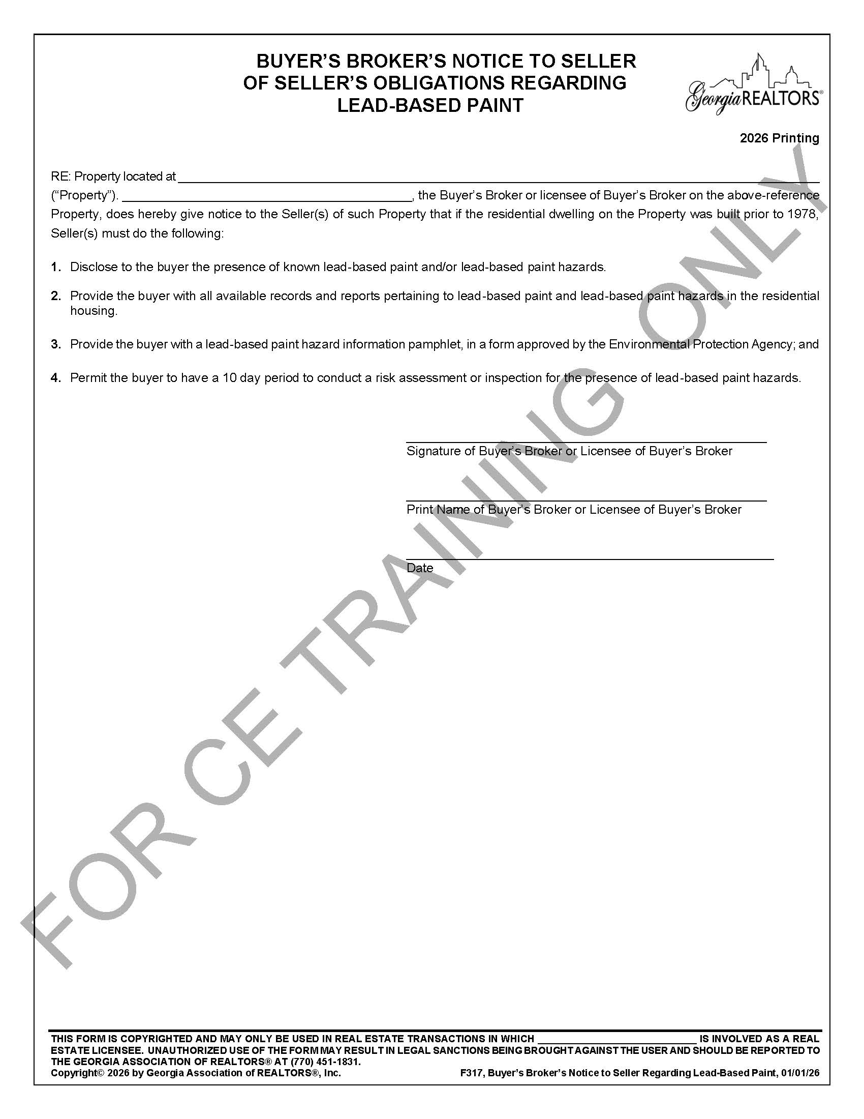
F317 Buyer’s Broker’s Notice to Seller of
Seller’s Obligations Regarding Lead-Based Paint

Slide 6
Common Contract Mistakes REALTORS® Make
Lead-Based Paint Issues
  b) Stipulating that seller will complete the lead-based paint disclosure after the Binding Agreement Date

Slide 7
Top 10 Contract Mistakes REALTORS® Make
#8 Not getting contract signed correctly when a legal entity is buying or selling the property

Slide 8
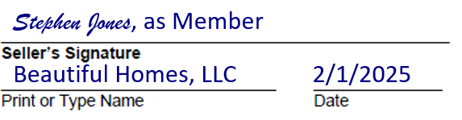
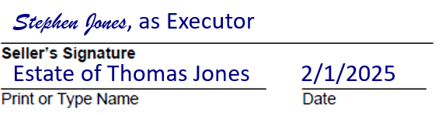
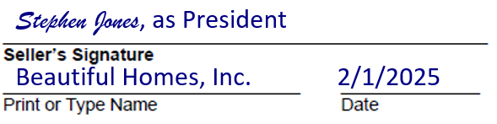
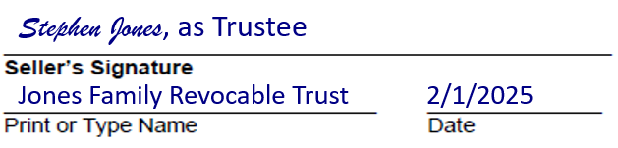
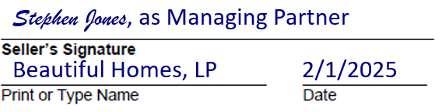
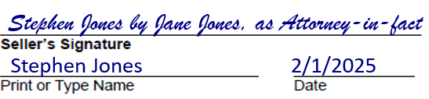
Top 10 Contract Mistakes REALTORS® Make

Slide 9
Top 10 Contract Mistakes REALTORS® Make
#7 Mistakenly thinking contracts expire if a party fails to close

Slide 10
Top 10 Contract Mistakes REALTORS® Make
#6 Writing stipulations that repeat boilerplate language in the contract.
Examples:
“Seller paid closing costs to be used for lender prepaids and escrow account set-up charges.”
“Buyer shall have the right to inspect the Property immediately before closing.”

Slide 11
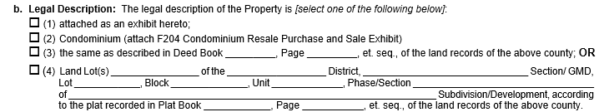
Top 10 Contract Mistakes REALTORS® Make
#5 Legal Description Errors:
Adding more than 1 legal description
Stipulating that seller will provide the legal description after the Binding Agreement Date
Using the fill-in-the-blank section for a metes and bounds description or filling in the blanks incorrectly
Marking that the legal description is attached and forgetting to attach it

Slide 12
Top 10 Contract Mistakes REALTORS® Make
#4 Loan Denial Letter Errors:
Sending a loan denial letter written by a lender other than the Approved Lender on the contingency exhibit
Sending a loan denial letter for the wrong loan
Sending a loan denial letter too late

Slide 13
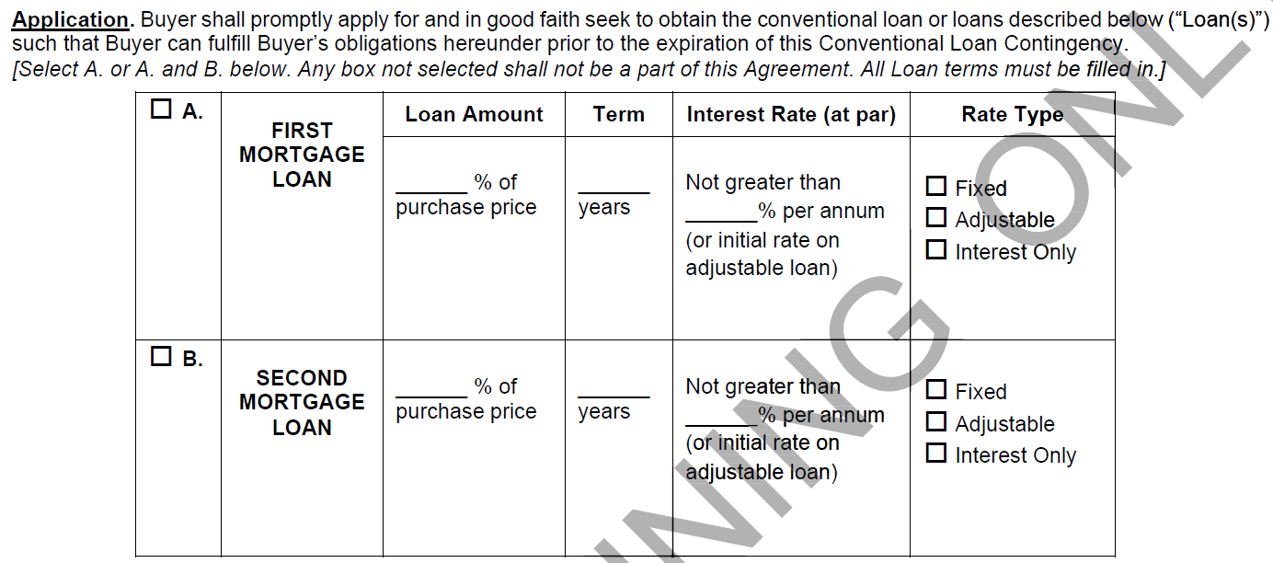
Top 10 Contract Mistakes REALTORS® Make
#3 Not filling in all the loan terms in the financing contingency

Slide 14
Top 10 Contract Mistakes REALTORS® Make
#2 Mistakenly relying on agent emails and texts as notice

Slide 15
Top 10 Contract Mistakes REALTORS® Make
#1 Terminating the contract prematurely

Slide 16
Top 10 Contract Mistakes REALTORS® Make
Scenario
Buyer is declined for financing after the financing contingency has expired but ten (10) days before the closing. The due diligence period has already expired. Buyer’s broker notifies seller’s broker of the same.
Seller immediately sends a unilateral termination notice to buyer citing that buyer was turned down for financing. Seller also requests the earnest money.
Who gets the earnest money?

Slide 17

Other Common Contract Mistakes REALTORS® Make

Slide 18
Common Contract Mistakes REALTORS® Make
Buyers not giving themselves enough time to evaluate repairs
Consider stipulating that seller must have all repairs completed 5 days before closing and must provide paid receipts

Slide 19
Common Contract Mistakes REALTORS® Make
Not getting sellers to update the Seller’s Property Disclosure Statement when new information is obtained

Slide 20
Common Contract Mistakes REALTORS® Make
Not getting sellers to update the Community Association Disclosure when it becomes outdated at year-end

Slide 21
Common Contract Mistakes REALTORS® Make
Buyer terminating the agreement a day or two before expiration of sale or lease contingency because their house sale hasn’t closed.

Slide 22
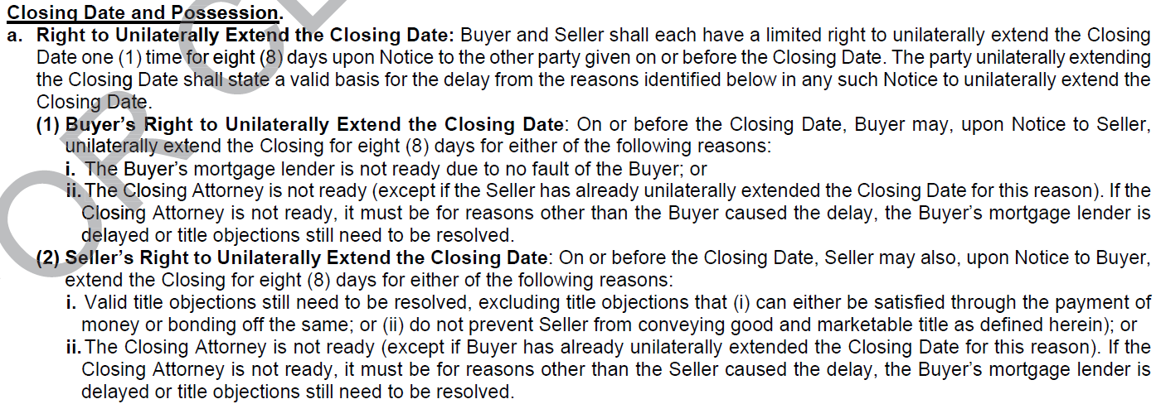
Common Contract Mistakes REALTORS® Make
Exercising 8-day unilateral extension for invalid reasons, too late, or without trying to amend the closing date first (when your client is the one unable to close)

Slide 23
Common Contract Mistakes REALTORS® Make
Relying on statements in the MLS without adding them to the contract
Example:
MLS says, “Charming 2500 square foot house” but house is only 2,000 square feet
If square footage matters to the buyer, then stipulate: “Seller warrants house is at least 2500 square feet of heated and cooled space excluding the basement.”

Slide 24
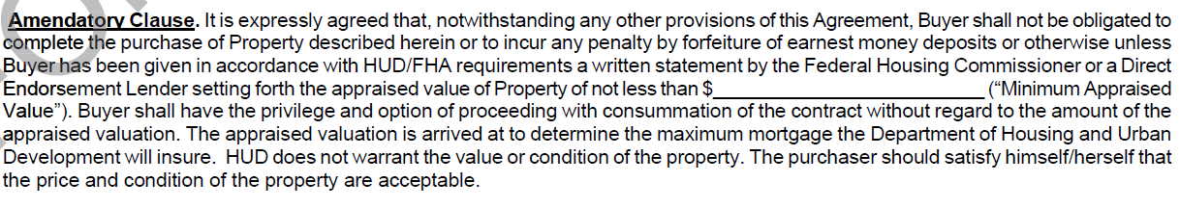
Common Contract Mistakes REALTORS® Make
Failing to update the Minimum Appraised Value on the FHA Exhibit if the price increases in a counteroffer.

Slide 25
Common Contract Mistakes REALTORS® Make
Not including an email address for an unrepresented buyer or seller on the signature page of the contract.

Slide 26
Common Contract Mistakes REALTORS® Make
Counting days incorrectly from the binding agreement date

Slide 27
Common Contract Mistakes REALTORS® Make
Example: The buyer has a 10-day due diligence period. The buyer accepts the seller’s offer on Saturday, November 1st. The buyer’s agent sends it to the listing agent on November 1st. The listing agent sends it to the seller on November 2nd. When does the due diligence period expire?

Slide 28
Common Contract Mistakes REALTORS® Make
Not filling in the Binding Agreement Date correctly or not objecting to an erroneous Binding Agreement Date within 1 day of receiving notice.

Slide 29
Common Contract Mistakes REALTORS® Make
Using Instructions to Closing Attorney to amend the Buyer’s Broker Compensation Agreement
Buyer agents not getting written confirmation in the contract as to what compensation the seller will pay
Having a Buyer’s Broker Compensation Agreement that conflicts with the Instructions to Closing Attorney

Slide 30
Common Contract Mistakes REALTORS® Make
As a buyer broker, asking for more compensation than what the buyer has agreed to pay

Slide 31
Common Contract Mistakes REALTORS® Make
As a buyer agent, asking for less compensation than what the seller is offering

Slide 32
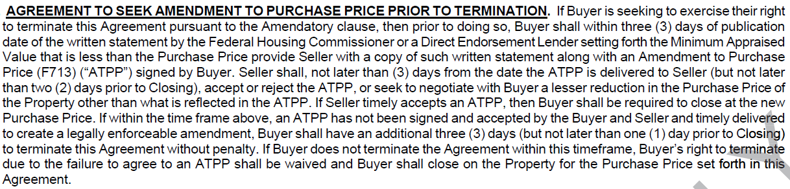
Common Contract Mistakes REALTORS® Make
When buyer is seeking a price reduction due to low VA/FHA appraisal, failing to deliver a copy of the appraisal and the Amendment to Purchase Price within 3 days of publication of the notice of value or minimum appraised value.

Slide 33
Common Contract Mistakes REALTORS® Make
Buyer failing to promptly notify seller of any mortgage lender to whom buyer has sent a notice of intent to proceed with loan application and the name and contact information for the loan originator.

Slide 34
Common Contract Mistakes REALTORS® Make
Not notifying clients whenever your agency relationship changes

Slide 35
Common Contract Mistakes REALTORS® Make
Not understanding what items stay with property or go with seller

Slide 36
Common Contract Mistakes REALTORS® Make
Allowing the seller to terminate the contract immediately when earnest money is not timely paid

Slide 37
Things REALTORS® Do That They Should Never Do

Slide 38
Things REALTORS® Do That They Should Never Do
Performing a walk-through inspection for a buyer

Slide 39
Things REALTORS® Do That They Should Never Do
Telling a buyer they don’t need a survey in Georgia

Slide 40
Things REALTORS® Do That They Should Never Do
Telling a buyer to waive title insurance if they are tight on cash to close.

Slide 41
Things REALTORS® Do That They Should Never Do
Agent serving as attorney-in-fact under a power of attorney for a client

Slide 42
Things REALTORS® Do That They Should Never Do
Giving verbal notice as a courtesy that your client is going to withdraw an offer or counteroffer before you give written notice

Slide 43
Things REALTORS® Do That They Should Never Do
Not knowing what to disclose as a listing agent when there are conflicting expert reports on whether an item in a house is a defect

Slide 44
Things REALTORS® Do That They Should Never Do
Not encouraging buyers to get follow-up inspections on items the inspector identifies as needing to be investigated further

Slide 45
Things REALTORS® Do That They Should Never Do
Allowing the buyer to inspect the property, particularly the attic, before they are under contract

Slide 46
Things REALTORS® Do That They Should Never Do
Qualifying broker being one of the designated agents

Slide 47
Things REALTORS® Do That They Should Never Do
As the listing agent, not identifying the source of your information in answering questions
BRRETA – O.C.G.A. § 10-6A-5
Brokers shall not knowingly give buyers false information; provided, however that a broker shall not be liable to a buyer for providing false information to the buyer if the broker did not have actual knowledge that the information was false and discloses to the buyer the source of the information.

Slide 48
Things REALTORS® Do That They Should Never Do
Tell clients and customers that they, as real estate agents, owe the client or customer a fiduciary duty

Slide 49


Questions?
Seth G. Weissman
seth@weissman.law
www.weissman.law

